Slide 1
Background to the Pacific Group on Disability Statistics(PGDS)
16 July 2020
Prepared by Michael Sharp (on behalf of the PGDS Working Group – Fiji, Samoa, UNICEF, SPC, DPO, WG(Loeb Mitch))
Statistics for Development Division
michaels@spc.int

Slide 2
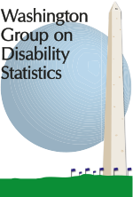
Greetings and acknowledgement
Notes:
UNICEF Pacific Disability Programme
University College London

Slide 3
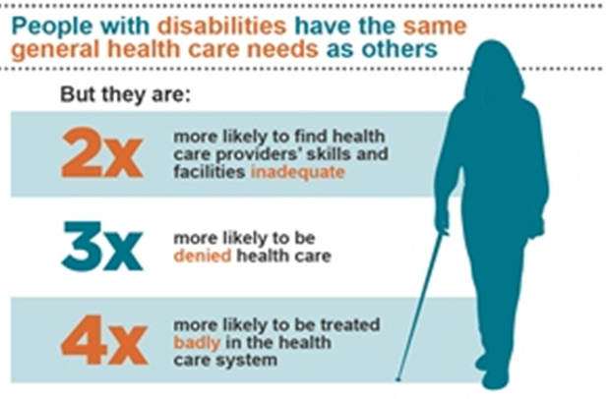
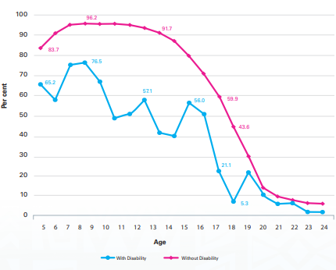
Disability Statistics Matter
At least 1.5 million Pacific Islanders are living with some form of disability.
Persons with disabilities in the Pacific are amongst the poorest and most marginalised in their communities.
They are overrepresented among those living in poverty and underrepresented in social, economic and public life, including in national decision-making.
Evidence shows that women with disabilities face unique, individualised barriers compared to both men with disabilities and people without disabilities.
Despite the Convention of The Rights for People with Disabilities (CRPD) stating that people with disabilities hold the same human rights as those without disabilities, all too often their access to education, employment, healthcare and social protection is not equal.
The establishment of the Pacific Group on Disability Statistics will facilitate increased collaboration amongst statistical and disability stakeholders in the production and use of disability statistics for forming and evaluating policy.
School attendance rates of persons with disabilities are lower than those without
(Kiribati, 2015)

Slide 4
Pacific Sustainable Development Indicators

Slide 5
The Pacific Group on Disability Statistics (PGDS)
History
In 2001, the Washington Group on Disability Statistics (WG) was constituted to address the global need for cross-nationally comparable population based measures of disability.
In 2013, the 4th Regional Conference of the Head of Planning and Statistics (HOPS) recommended the improvement and standardisation of the collection and compilation of disability statistics in the Pacific region.
In 2016, a regional workshop was held to strengthen capacity to collect and use disability statistics. At this workshop, it was first proposed that group focused on disability statistics be established. Ongoing discussions in this regard occurred at subsequent workshops in 2017 and 2018.
From 2018 to 2020, UNICEF and SPC collaborated in the implementation of the DFAT funded Pacific Disability Program where significant progress occurred in the production, analysis and dissemination of disability statistics, and the strengthening of partnerships amongst statistical and disability stakeholders – many who are members of PGDS.
In 2020, the establishment of the PGDS was formalised during a regional workshop where the Terms of Reference were drafted and the membership and scope of work defined.
Notes:
We’d like to acknowledge the Washington Group for their technical support and the University College London and DFAT for their financial support.

Slide 6
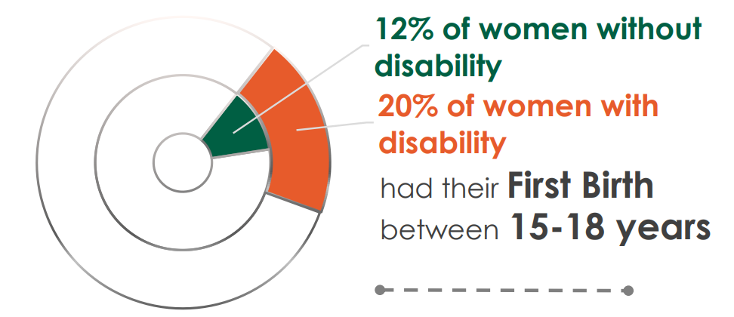
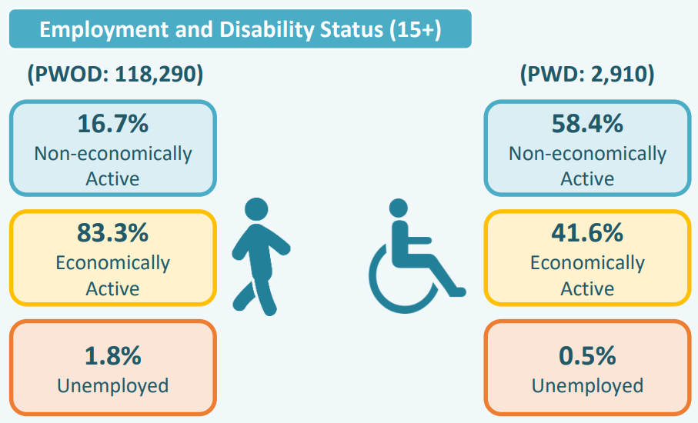
The Pacific Group on Disability Statistics (PGDS)
Source: Samoa Population and Housing Census (2016)
Membership
Representatives of national statistics agencies of the 22 Pacific Island countries and territories (PICTs).
Representatives of national ministerial disability focal points.
Representatives of disabled people’s organisations.
Representatives of regional and international organisations.
Notes:
We’d like to acknowledge the Washington Group for their technical support and the University College London and DFAT for their financial support.

Slide 7
The Pacific Group on Disability Statistics (PGDS)
Scope of work
The scope of work for the PGDS will be to support PICTs in the production and use of reliable, valid and comparable disability statistics through facilitation, cooperation, engagement and capacity building, including through Peer-to-Peer collaboration. The focus of PGDS is on disability statistics, however it will also include other intersectional interests, such as, women and gender.
Enhance cooperation and facilitation: identify focal points; establish a network and database of key stakeholders.
Engage stakeholders: set routine meeting schedule for key stakeholders; map disability data availability along with the methodology or tools used for collection; undertake SWOT analysis in each country to identify needs and capacity gaps.
Strengthening capacity: provide training in data collection, analysis and dissemination using the Washington Group tools; support cross-country collaboration (incl. Peer-to-Peer); standardize analytical tools and methods with the goal of delivering standard dissemination products.

Slide 8
The Pacific Group on Disability Statistics (PGDS)
Anticipated outputs
All censuses and nationally representative surveys conducted in the region include the WG tools. Resulting data are analysed in a consistent and uniform manner.
Results are disseminated according to region-specific framework by 2030.
A Regional Guidebook to Improve Disability Data Collection and Analysis in the Pacific region.
A regional Disability Monograph is generated by 2030.

Slide 9
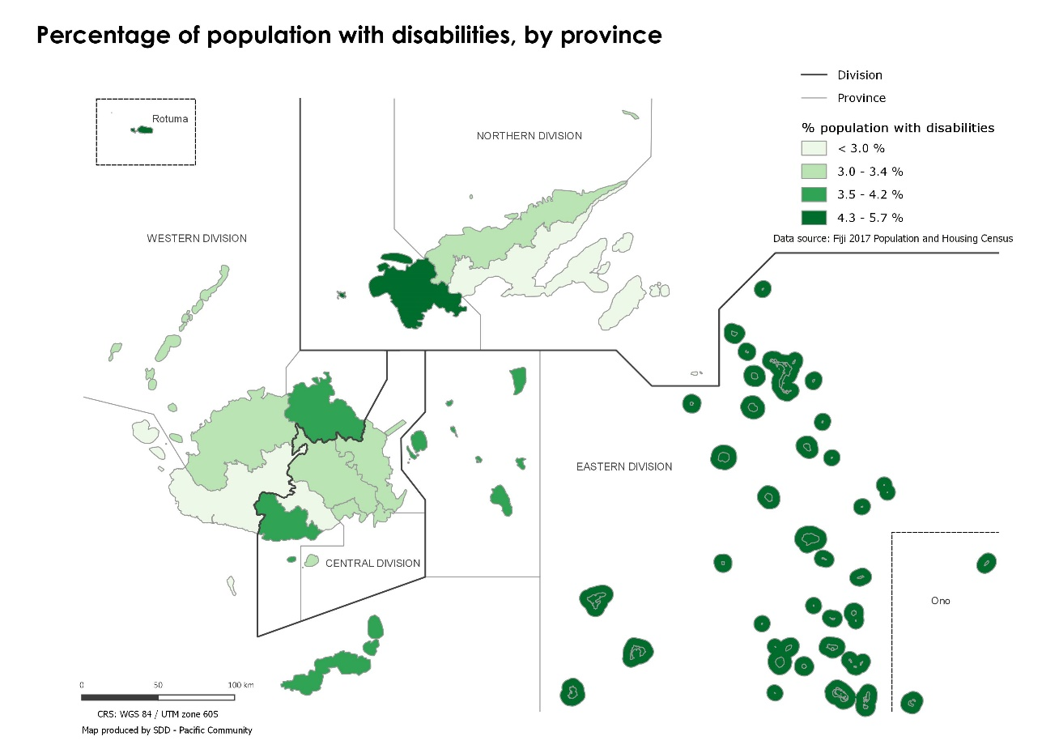
Expectations from the meeting
Background to the WG tools.
Lessons learned from statistical agencies who have implemented the WG tools and analysed the data.
Sharing of experience of DFP/DPOs in the use of disability statistics in policy and planning.
Knowledge sharing from regional and international organisations and partners.
Discussion on PGDS’s TOR.
Disability prevalence rate, by province (Fiji, 2017)

Slide 10
Thank you!

