Slide 1
COVID and Disability Data Collection Activities
Finland
Päivi Sainio and Seppo Koskinen

Slide 2
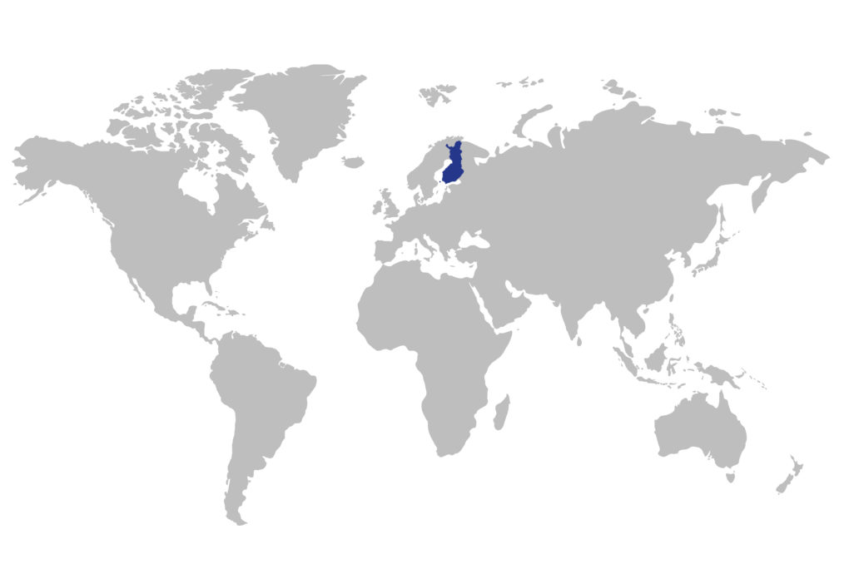
Finland:
Total population 5,5 million
Capital Helsinki
The surface area is 338,432 km²
The neighbouring countries are Russia (east), Norway (north), Sweden (west) and Estonia (south)
Official languages: Finnish, Swedish
Source: https://toolbox.finland.fi/seasons-destinations/finland-on-the-world-map/

Slide 3
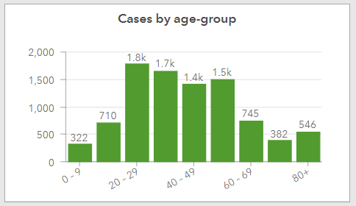
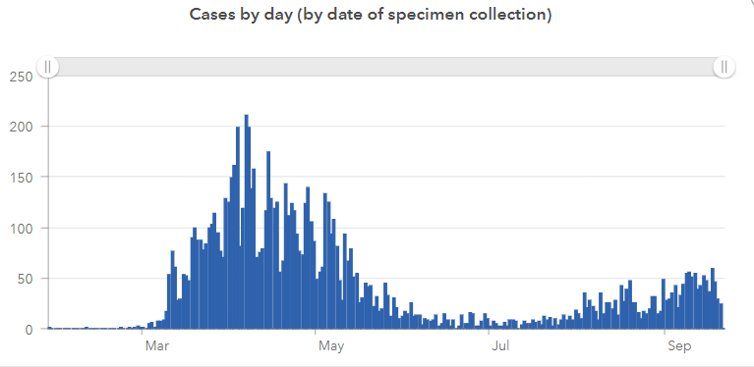
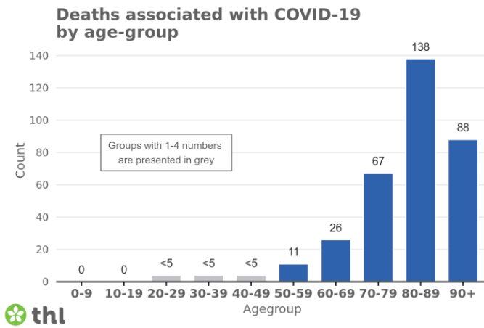
Coronavirus in Finland, Sept 21th
Reported cases: 9046
In hospital care: 16
In intensive care: 3
Deaths: 339
Cases / 100 000 160

Slide 4
Population surveys: disability and the impact of COVID
Four data collections between Autumn 2020-Spring 2021:
  Adult population, cross-sectional study, n=60 000
  Adult population, follow-up study, n=10 000
  Children and youth 10-20 years, cross-sectional study, n≈ 388 000
  People with foreign background, 18-64 y, follow-up study, n=7 800
Samples from the Population register, representing Finnish population / foreign born population
Comprehensive contents on health, wellbeing, services, etc.+questions on COVID-19 impacts on everyday life
Disability questions based on Washington Group (modified): at least seeing, hearing, mobility and cognition

Slide 5
Research questions, examples
Disaggregation by disability
What is the impact of the COVID-19-related restrictions on everyday life, health and wellbeing, services etc.
Have the differences between people with and without disabilities become larger or smaller? Population level changes (comparison with data collected before the pandemic)
What are the individual level changes among people with disabilities compared to people without disabilities?
Intersectionality: e.g. foreign born people with disabilities

Slide 6
Data to be collected from people with disabilities (PwD) and other stakeholders
  As a part of a development project, information on the impact of COVID-19 is to be gathered from PwD, service producers and local authorities
  Using the findings from the interviews and those based on population surveys, different stakeholders (PwD, DPOs, service providers, authorities of the municipalities, THL, etc.) will work together
  To develop instructions, plans and operational models for use in municipalities
  To produce accessible information for PwD
  The project aims to support the functioning of PwD in the future crises so that their needs and rights will be respected

Slide 7
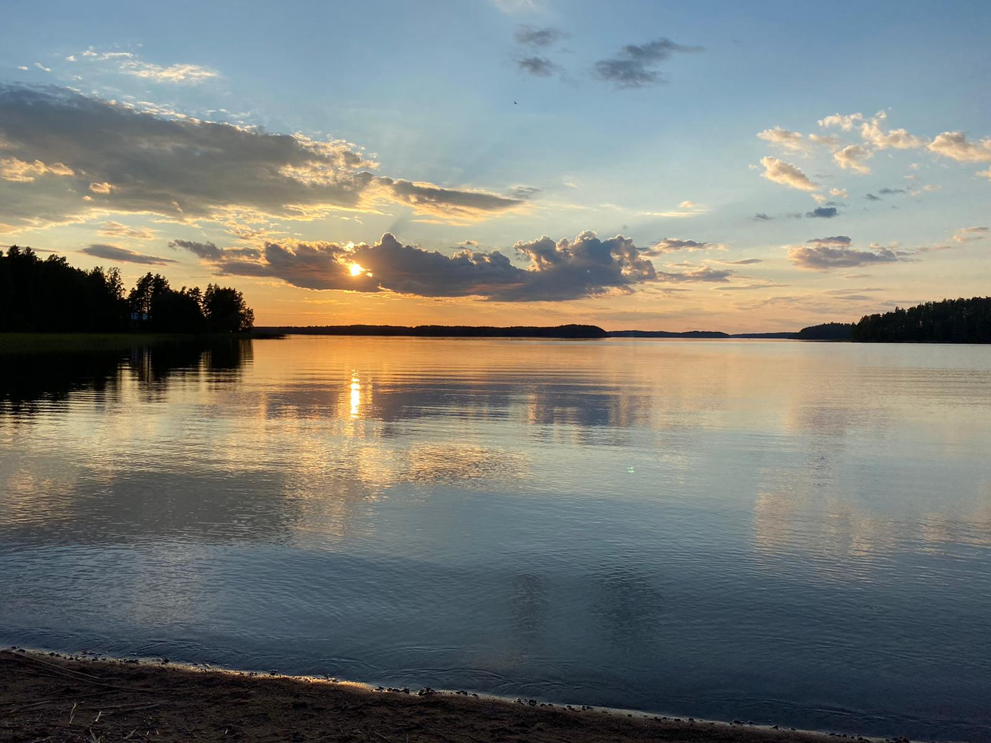
Thank you!
Photo by Suvi Sainio: the lake of Saimaa, Eastern Finland

