Slide 1
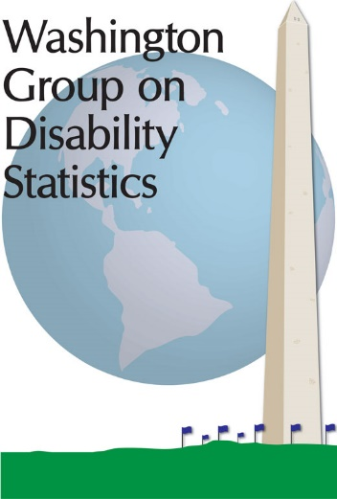
WG Country Reports: Reported COVID and Disability Data Collection Activities
Twentieth Meeting of the Washington Group on Disability Statistics
22 – 24 September 2020
Cordell Golden (U.S.A.)
National Center for Health Statistics
WG Secretariat

Slide 2
Annual Report on National Activities Related to Disability Statistics - Country Reports
Part of WG Governance
Each country representative is responsible for maintaining communications with other parties in their country who have expressed an interest in the work of the WG
Provides a vehicle for a larger group of experts to have input into WG activities
Country report form distributed to countries with a designated WG representative
Summary of information collected is presented at the annual WG meeting

Slide 3
Items included on WG Country Reports
Report on recent and planned data collection efforts on disability:
Type:
Census
Short disability module in ongoing survey
Longer disability module or disability survey
Demographic and Health Survey (DHS)
Multiple Indicator Cluster Survey (MICS)
Name of survey/census and administering agency
Date of data collection
Frequency
Sample design: Coverage / Sample size / Sampling frame
Mode
Language(s) administered
Administrative Records

Slide 4
WG Country Reports: Questions related to WG specific activities
2006 – Started monitoring the use of WG Short Set (WG-SS)
2009 - Added question on the use of WG-SS in 2010 census round
2011-2013 - Added tables for reporting disability prevalence rates by geographical division, age, sex
2015 - Expanded questionnaire to capture:
Date of most recent census using WG-SS
Previous use of WG Extended Set on Functioning (WG-ES)
Ability to disaggregate the following indicators by disability status us WG-SS:
School attendance
Employment status
Information and Communications Technology (ICT) usage and access

Slide 5
WG Country Reports: Questions related to WG specific activities
2016 - Added questions about plans to use WG-SS and WG-ES
2017 - Added questions about plans to use WG/UNICEF Child Functioning Module (CFM)
2018 - Added questions on the use of administrative data sources to produce disability status indicators for disaggregation
2019 - Allowed respondents to indicate that a subset of the WG-SS, WG-ES or CFM was used
2020 - Added response options to indicate use of WG-SS Enhanced
Added questions about COVID and disability data collections

Slide 6
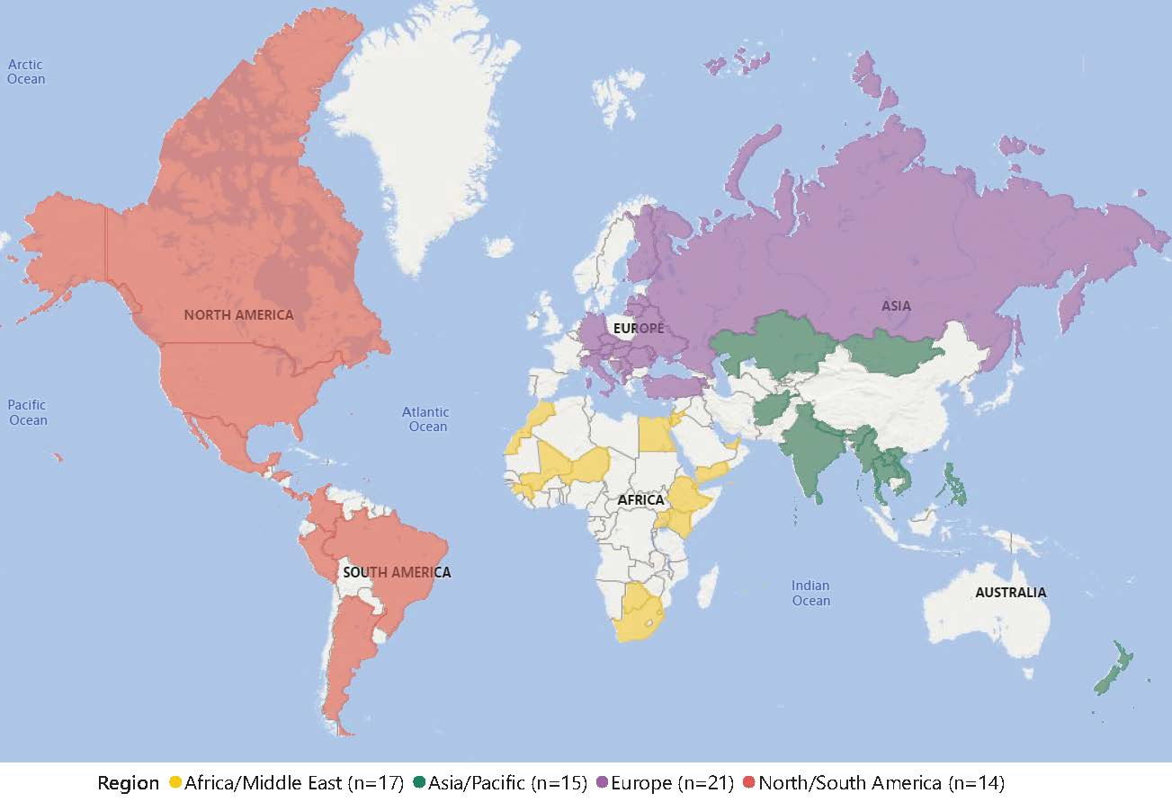
2020 WG Country Reports: Responding Countries (n=67)

Slide 7
Reported Data Collection Activities Related COVID and Disability

Slide 8
Aware of COVID-19 Data Collections Activities that also include Disability Questions
Country | Results Available | Country | Results Available
1) Albania | √ | 9) Maldives | √
2) Botswana |  | 10) Moldova
3) Canada | √ | 11) Mongolia | √
4) Djibouti |  | 12) New Zealand | √
5) Eswatini |  | 13) Niger
6) Finland |  | 14) Sri Lanka
7) Italy |  | 15) United States | √
8) Kenya | √ | 16) Vietnam | √
Includes subset of WG-SS
Includes WG-SS
Includes WG-SS Enhanced

Slide 9
COVID and Disability: Types of Data Collection Activities
Administrative Data (Botswana, Mongolia)
Labour Force/Employment Survey (Eswatini, Italy, New Zealand, Sri Lanka, United States)
National Health Survey (Finland, New Zealand)
Serological Follow-up Survey (Finland)
Socio-economic Impact Survey (Kenya, Maldives, Moldova, Vietnam)
Survey Targeting People with Long-term Conditions or Disabilities (Canada, Djibouti)
Unspecified (Albania, Niger)

Slide 10
Monitoring the use of the WG-SS

Slide 11
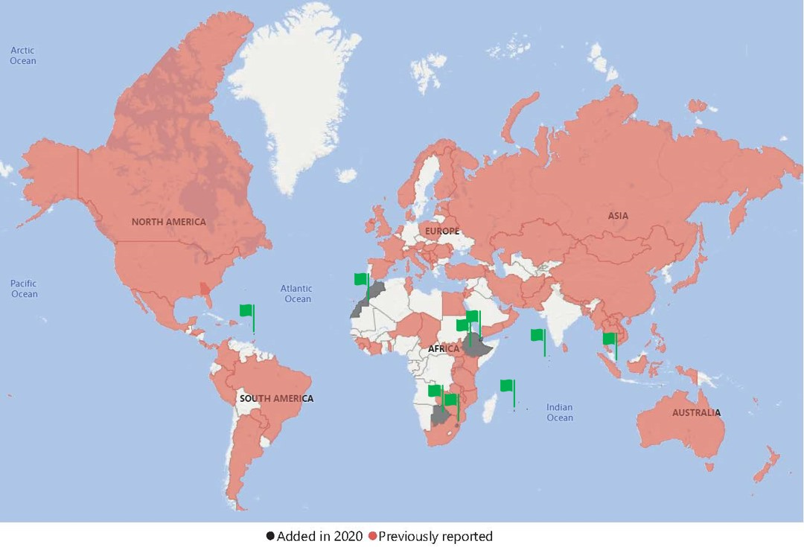
Reported use of the WG-SS
Source: 2009-2020 WG Country Reports (n=107)

Slide 12
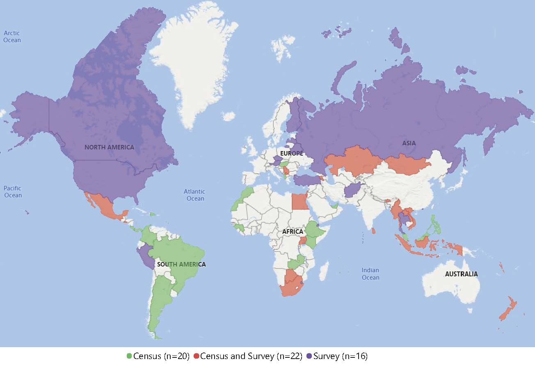
Where is the WG-SS going? Countries reporting that the WG-SS or a subset will be used in the 2020 Census Round or an upcoming survey (2019 – 2029)
Source: 2019 and 2020 WG Country Reports (n=58)

Slide 13
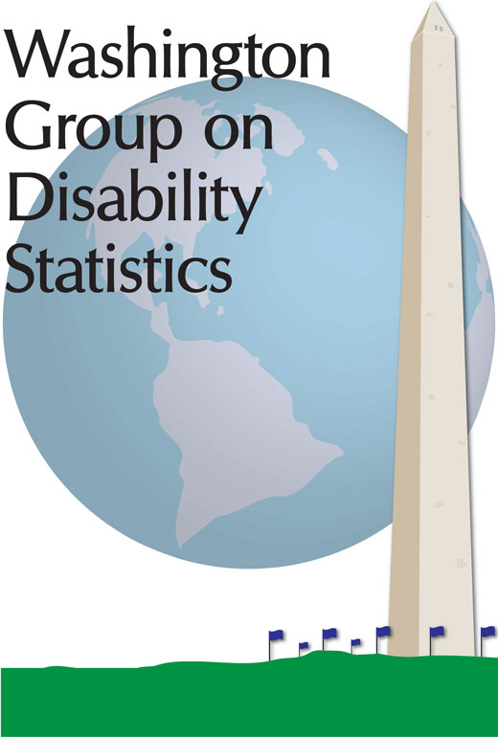
Please contact the WG Secretariat for additional information about the use of the WG data collection tools and country-specific activities: WG_Secretariat@cdc.gov

