Slide 1
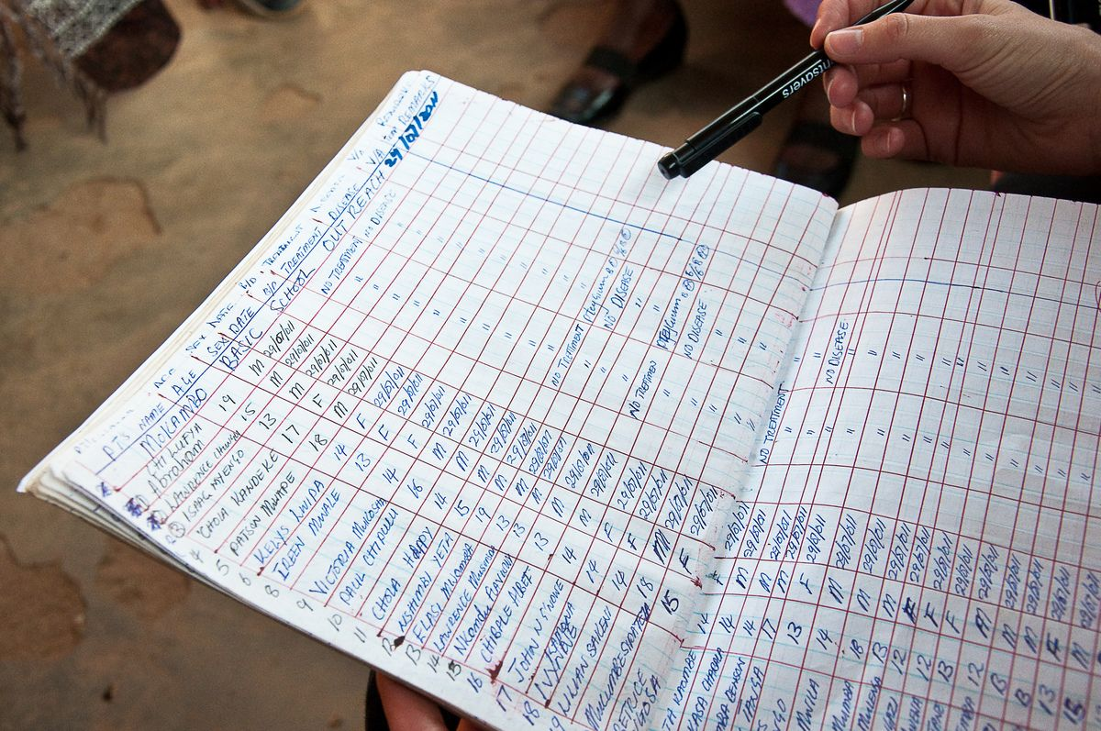
DATA DISAGGREGATION IN PROJECTS
Rachel Murphy
December 7-9, 2016

Slide 2
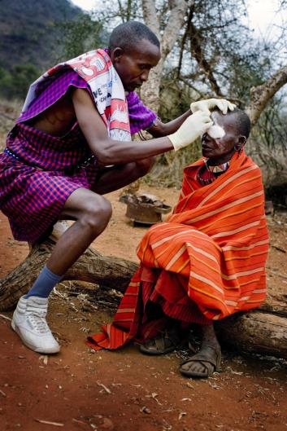
Sightsavers
NGO founded in 1950
Our Mission:
To eliminate avoidable blindness and promote equality of opportunities for people with disabilities
Thematic areas:
Eye health, neglected tropical disease, inclusive education and social inclusion programmes

Slide 3
Disability Disaggregation project
The objectives of this project were to:
Understand whether people with disabilities are accessing our services
Build the evidence base on how to disaggregate routine data by disability
Make Sightsavers projects more inclusive of people with disabilities.
Why disaggregate data by disability?
Sightsavers’ Empowerment and Inclusion Framework
Sustainable Development Goals & ‘Leaving no one behind’
Goal 17: Revitalize the global partnership for sustainable development
To influence others with evidence e.g. NGOs, donor agencies

Slide 4
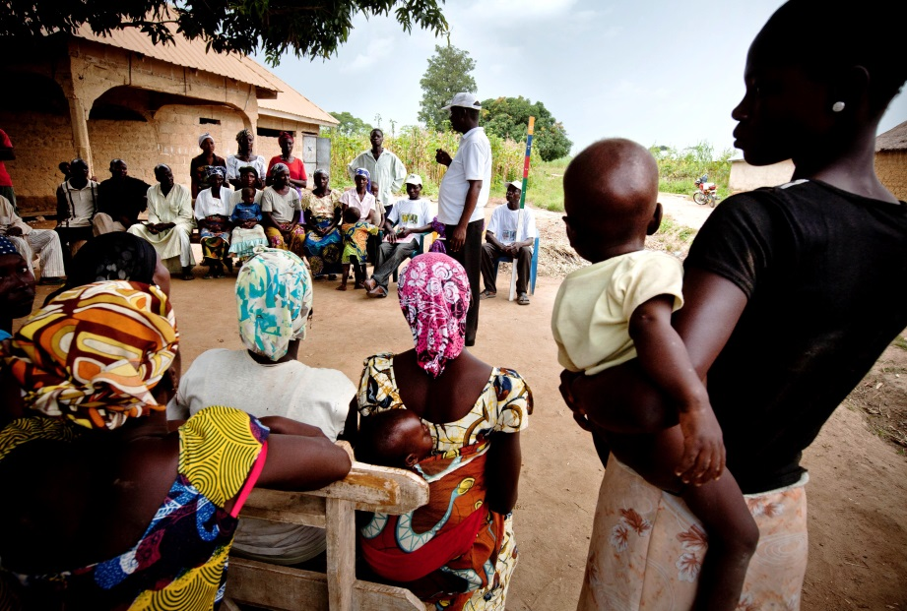
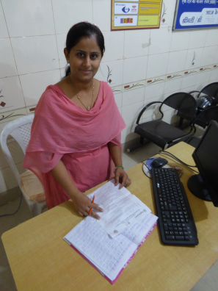
Methods
Integrated WG Short Set of Questions into routine data collection systems to understand the disability status of patients attending our programmes (Africa and Asia)
Analysed disability data (descriptive, univariate and multivariate associations between the variables) and developed reports
As part of this pilot we also collected data on:
Experiences of people involved in the project (qualitative)
Quality of the data

Slide 5
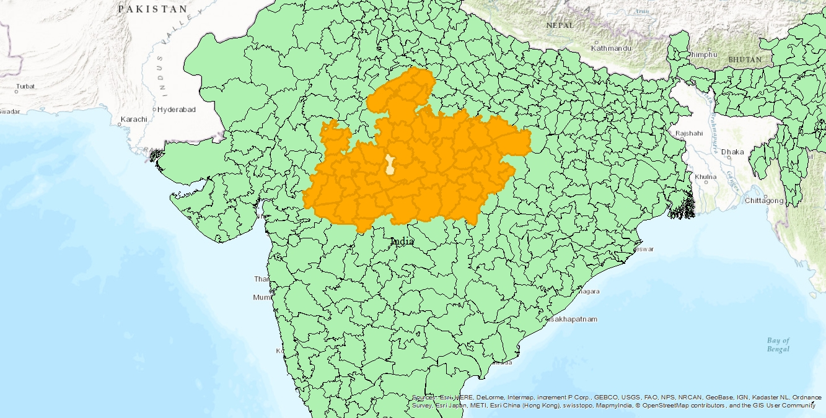
India
Integrated WGSS and the India census question on disability into Urban Eye Health programme
24,518 patients over a 16 month period attended
3 Vision & Optic centres
Outreach Camps
One NGO Eye Health Hospital
Bhopal District,
Madhya Pradesh State

Slide 6
Tanzania
Integrated WGSS into data collection at Trachoma Trichiasis (TT) camps
Integrated approach to Neglected Tropical Disease (NTD) elimination
1,439 patients asked over 4 months
Compared the data with 2008 disability survey
Songea district, Ruvuma region

Slide 7
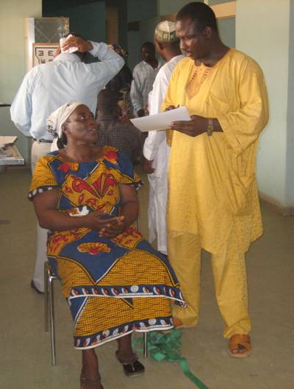
Cameroon
Integrated WGSS into Rapid Assessment of Avoidable Blindness (RAAB)
Data collected on 3,567 patients over a 3 month period
Fundong, North-West District

Slide 8
Malawi
Integrated WGSS and Equity Tool into data collection systems at TT camps
545 patients asked over 6 days
Compared the data with Equity Tool national quintiles (disability data not currently available)
Karonga District
Kasungu District

Slide 9
India – Results
17.5% reported disability (a lot or cannot do at all in at least one domain).
9% when we exclude the sight domain.
0.6% when we ask them directly if they are ‘disabled’

Slide 10
India – Results
Univariate associations with disability measures
Variable | Values | WG a lot or worse | WG a lot or worse (excluding seeing) |  | Are you disabled?
 |  | Odds ratio
Sex | Male | - |  | - | -
 | Female | 1.4*** |  | 2.1*** | 0.7*
Age - binary | <50 | - |  | - | -
 | 50+ | 3.4*** |  | 3.3*** | 1.7**
Location | Hospital | - |  | - | -
 | Primary centre | 8.2*** |  | 42.5*** | 5.5***
* p-value < 0.05
** p-value < 0.01
***p-value < 0.001

Slide 11
Tanzania – Results

Slide 12
Tanzania - Results

Slide 13
Cameroon - Results

Slide 14
Malawi - Results

Slide 15
Key lessons learned
Disability is a concept highly dependant on contextual and cultural factors
Emphasis on sensitisation/training & translation
Data collection systems can be resistant to change
Integrate in existing tools & process
Buy-in & Ownership
Equip all stakeholders with necessary knowledge & tools
Data collection itself has a transformative effect
Essential as an integral part of an inclusive health programme
Need to be followed by inclusive health strategies

Slide 16
Next Steps
Continue to gather learning
Pilot project in Ghana (Mass Drug Administration)
Continue to collect data as part of ‘Inclusive Eye Health Projects’
Link disability data with other variables (e.g. equity tool)
Looking at piloting the WG/UNICEF Child Functioning Module
Use the disability data collected to inform our programmes
Share learning with civil societies and NSO
Publish reports & policy brief with clear recommendations
Web page on the project: www.sightsavers.org/everybodycounts
Influence the international agenda:
Expert Group on data disaggregation
Presentation at international conferences
Support the implementation of the 2030 Agenda

Slide 17
For more information please contact: rmurphy@sightsavers.org

