Slide 1
Sharing Australia’s experiences: Disability statistics nationally and internationally
Washington Group on Disability Statistics (WG16)
Pretoria, December 2016
Katie Magee
Assistant Director, Disability Section
Development Policy and Education Branch
Development Policy Division

Slide 2
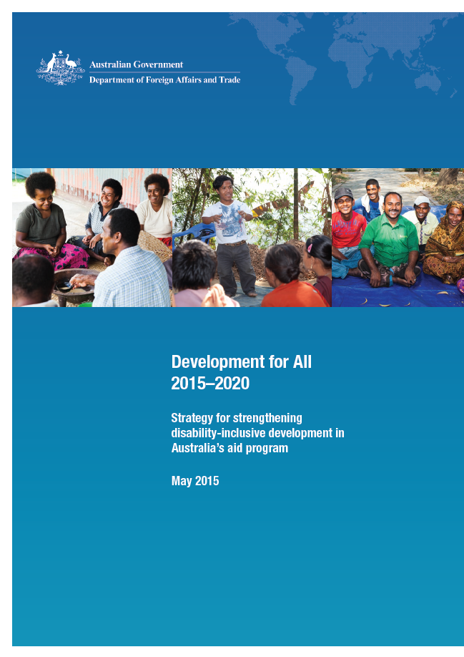
Development for All 2015-2020: Strategy for strengthening disability-inclusive development in Australia’s aid program

Slide 3













International disability partnerships
Australian Development Research Awards Scheme
UN Special Rapporteur on the
Rights of Persons with Disabilities

Slide 4


Strengthening disability data collection and analysis globally

Slide 5

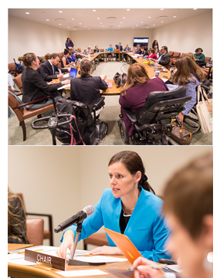
  Global Action on Disability (GLAD) Network
  The GLAD Network is an international group of donors, multilateral agencies, foundations and philanthropic organisations, and private sector entities actively contributing resources internationally to disability inclusive development
  GLAD promotes international cooperation on disability-inclusive development
  DFAT and IDA co-chairs of GLAD in 2016-17
  GLAD Steering Committee meeting held in New York in June 2016
  GLAD Network meeting in Berlin in March 2017
Photo: DFAT Photo/Miller Lokanata

Slide 6

Sharing Australia’s experiences – disability statistics nationally and internationally
Suraksha Maharaj
Director
Disability, Ageing and Carers National Statistical Centre

Slide 7

Survey of Disability, Ageing and Carers
Prevalence of disability in Australia
Socioeconomic information
Carers information
Demographic information
Older Australians
Need for support of those with disability

Slide 8


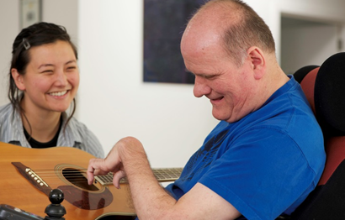
The 2016 Supplementary Disability Survey
The 2016 SDS was conducted in collaboration with the Australian Department of
Foreign Affairs and Trade to provide an internationally comparable disability
measure for Australia
Washington Group Short Set on Functioning questions
Voluntary follow-up survey, sampled from SDAC
6,213 households
(13,837 people)
Computer-assisted
telephone interviews

Slide 9

The 2016 Supplementary Disability Survey
Respondents were asked about their level of difficulty because of a health problem
Weights calculated based on SDAC 2015
Estimated resident population benchmarks (ERP) and person level benchmarks from the SDAC

Slide 10
Comparing disability surveys
When comparing disability prevalence rates from Australia it’s important to be aware
of the different approaches used
 | SDAC | SDS | WG Short Set
Age | All ages | Aged 5 years and over | Adult population
Scope | Households and establishments | Households only
Interview method | Computer-assisted personal interviews | Computer-assisted telephone interviews | Face-to-face
Respondent | Any adult followed by personal interviews or proxy interviews | Adult providing information on behalf of household | Individual (self-response)
Number of questions | Up to 150 | 6 questions | 6 questions

Slide 11
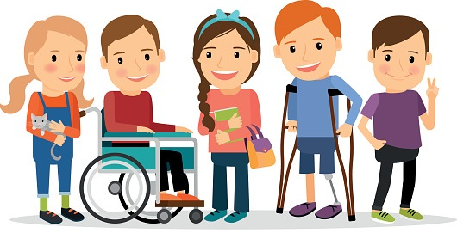
Results from Australia’s WG survey
6.7% of Australians reported disability
5.9% of males
7.3% of females

Slide 12
Results from Australia’s WG survey
As expected, the WG disability prevalence increased with age

Slide 13
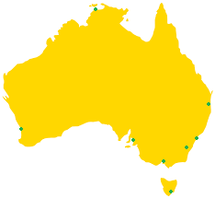
Results from Australia’s WG survey
9.5% of those living outside of capital cities had disability
5.3% of those living in capital cities had disability

Slide 14
Results from Australia’s WG survey
Disability prevalence varied across the six WG domains
Domain | %
Seeing | 0.9%
Hearing | 1.6%
Walking or climbing stairs | 4.1%
Remembering or concentrating | 1.6%
Self care | 0.9%
Communication | 0.6%
People with disability are those who reported a lot of difficulty or cannot do at all.

Slide 15
Lessons from the field
Interviews were, on average, 2.9 minutes per household
Some interviewers noted comprehension concerns, for example needing to reinforce and repeat the statement even if wearing glasses or wearing a hearing aid
The mobility module was reportedly well understood
Interviewers suspected under-reporting of difficulty for ‘remembering and concentrating’ with respondents sharing experiences of having difficulty then often answering No difficulty
Some interviewers would have preferred more information on the WG and modules

Slide 16
Comparing Australia’s WG and SDAC results
The SDAC identified just over 4 million Australians as having a disability, while the WG questions gave an estimate of 1.3 million
The positive and negative predictive values of the WG questions were both 85%, indicating that when the WG questions identified someone with or without disability, this was usually correct
 | SDAC – with disability | SDAC – without disability | Total
WG – with disability | 85% | 15% | 100%
WG – without disability | 15% | 85% | 100%
Total | 19% | 81% | 100%

Slide 17
Comparing Australia’s WG and SDAC results
The sensitivity was low at 26%, indicating the WG questions missed a large portion of the population who live with disability
In contrast specificity was high at 99%, indicating the WG questions could accurately identify those who do not live with disability
 | SDAC – with disability | SDAC – without disability | Total
WG – with disability | 26% | 1% | 6%
WG – without disability | 74% | 99% | 94%
Total | 100% | 100% | 100%

Slide 18
Comparing Australia’s WG and SDAC results
For people that SDAC identified as having a loss of hearing, the WG questions
identified around 34% of this group as living with disability
Disability Type | %
Loss of hearing | 34%
Difficulty learning or understanding things | 37%
Speech difficulties | 47%
Loss of sight | 50%
Incomplete use of feet or legs | 51%
Memory problems or periods of confusion | 64%

Slide 19
Comparing Australia’s WG and SDAC results
For people that SDAC identified as having a loss of sight, the WG questions
identified around 50% of this group as living with disability
Disability Type | %
Loss of hearing | 34%
Difficulty learning or understanding things | 37%
Speech difficulties | 47%
Loss of sight | 50%
Incomplete use of feet or legs | 51%
Memory problems or periods of confusion | 64%

Slide 20
Comparing Australia’s WG and SDAC results
For people that SDAC identified as having memory problems or periods of confusion,
the WG questions identified around 64% of this group as living with disability
Disability Type | %
Loss of hearing | 34%
Difficulty learning or understanding things | 37%
Speech difficulties | 47%
Loss of sight | 50%
Incomplete use of feet or legs | 51%
Memory problems or periods of confusion | 64%

Slide 21
Comparing Australia’s WG and SDAC results
As severity of disability increased so too did the WG questions ability to correctly
identify someone as living with disability

Slide 22
Comparing Australia’s WG and SDAC results
The WG questions were better able to detect disability in those in lower
socioeconomic groups and in older age groups
More disadvantage

Slide 23
Comparing Australia’s WG and SDAC results
There were also some interaction effects
Disability Type | Males | Females
Nervous or emotional condition | 29% | 36%
Difficulty gripping or holding things | 41% | 36%
Loss of hearing | 31% | 38%
Social or behavioural difficulties | 36% | 41%
Speech difficulties | 47% | 47%
Loss of sight | 47% | 53%
Incomplete use of feet or legs | 47% | 54%
Memory problems or periods of confusion | 66% | 62%

Slide 24
Comparing Australia’s WG and SDAC results
Seeing
WG Response
Where a person had no loss of sight, WG questions also showed this
Where a person had partial or total loss of sight, they fell into a range of WG categories

Slide 25
Comparing Australia’s WG and SDAC results
Hearing
WG Response
Where a person had partial or total loss of hearing, they fell into a range of WG categories
Where a person had no loss of hearing, WG questions also showed this

Slide 26
Comparing Australia’s WG and SDAC results
Mobility
WG Response
A mix of responses in people with the most mobility restriction, although the WG performed a little better than the sight and hearing domains

Slide 27
Comparing Australia’s WG and SDAC results
Cognition
WG Response
Cognition was one of the domains where the WG questions performed the strongest
Again, here we see high specificity

Slide 28
Comparing Australia’s WG and SDAC results
Self-care
WG Response
Again, here we see high specificity
And a range of outcomes where a person has a severe or profound self-care limitation

Slide 29
Comparing Australia’s WG and SDAC results
Communication
WG Response

Slide 30
Comparing Australia’s WG and SDAC
Differences in survey methodology may explain some of the observed differences
in Australia’s WG disability estimates compared to the SDAC
We are currently considering what effect the following had:
Interview method – using a phone interview?
Respondent – answering for all in household?
Number of questions – 6 compared to an extensive set?
Collection mode – follow up survey?
Question format – asking question for each domain of everyone in household before proceeding to next domain?
Interviewer training– more supporting material for interviewers?

Slide 31
Thank you
Contact us
disability.statistics@abs.gov.au
Suraksha.Maharaj@abs.gov.au

