Slide 1
Untangling Disability and Poverty: A Matching Approach Using Large-scale Data in South Africa
Kengo Igei
Japan International Cooperation Agency Research institute
igei.kengo@jica.go.jp
The 16th meeting of the Washington Group on Disability Statistics, Pretoria, South Africa
December 8, 2016

Slide 2
Motivation of the analysis
Two challenges in the analysis of disability and poverty
1. Two-way causality between disability & poverty:
Observed poverty gap between PWDs & non-PWDs
= caused by disability? existing before acquiring disability?
=> Exact Covariate Matching & Matching-based decomposition
2. Different impact of disability by subgroup
Mitra (2006, 241): “(a)n impairment is a prerequisite to disability, but it is only one of the factors, along with the person’s other characteristics (e.g., age, gender, race), the resources available, and the environment, that lead to capability or functioning deprivation—in other words, to disability.”
Obstacle against analysis: small number of PWDs in dataset
=> Use a large-scale data in South Africa

Slide 3
Data
10% sample of the Population Census 2011 in South Africa (Stat SA 2015a)
  Sample size: 4,337,697 persons in 1,194,122 households
  Washington group short set of disability questions
    6 types of difficulties: Seeing, Hearing, Communication, Walking/Climbing stairs, Remembering/Concentrating, Self-care (washing all over, dressing, or feeding)
    4 levels of difficulty :
    － “No difficulty”
    － “Some difficulty”
    － “A lot difficulty” = “Moderate”
    － “Cannot do at all” = “Severe”
Persons w/o disabilities
Persons w. disabilities

Slide 4
Data
    Sample of analysis：PWDs & non-PWDs aged 6-64
    Exclude the following sample:
      Those with “some difficulty”
      Aged 6-14 with difficulties in self-care
    <= Possibility of misreporting（Stat SA, 2014）
    => Final sample size
    ＝2,748,999 including 90,867 PWDs (3.3%)

Slide 5
Age distribution of PWDs & non-PWDs

Slide 6
Characteristics of PWDs and Non-PWDs
 | Age: 6-14 |  |  | Age: 15-24 |  |  | Age: 25-39 |  |  | Age: 40-54 |  |  | Age: 55-64
 | PWD | Non- PWD |  | PWD | Non- PWD |  | PWD | Non- PWD |  | PWD | Non- PWD |  | PWD | Non- PWD
 | (1) | (2) |  | (3) | (4) |  | (5) | (6) |  | (7) | (8) |  | (9) | (10)
Gender (%)
Male | 53.1 | 50.5 |  | 50.0 | 49.8 |  | 47.7 | 49.2 |  | 40.3 | 47.2 |  | 40.0 | 46.1
Female | 46.9 | 49.5 |  | 50.0 | 50.2 |  | 52.3 | 50.8 |  | 59.7 | 52.8 |  | 60.0 | 53.9
Race (%)
African | 90.5 | 84.0 |  | 87.4 | 84.5 |  | 85.3 | 80.9 |  | 82.9 | 71.8 |  | 81.4 | 65.3
Coloured | 5.7 | 8.9 |  | 7.0 | 8.3 |  | 7.3 | 8.6 |  | 9.6 | 11.5 |  | 9.4 | 10.4
Indian | 1.2 | 1.8 |  | 1.7 | 2.0 |  | 2.3 | 2.7 |  | 2.2 | 3.4 |  | 2.4 | 3.9
White | 2.6 | 5.3 |  | 3.8 | 5.2 |  | 5.1 | 7.8 |  | 5.2 | 13.3 |  | 6.8 | 20.4
Residence area (%)
Urban area | 47.0 | 54.4 |  | 54.9 | 59.0 |  | 62.9 | 70.8 |  | 61.3 | 70.4 |  | 57.4 | 65.6
Rural formal area | 3.4 | 3.5 |  | 3.5 | 3.6 |  | 4.1 | 4.1 |  | 4.5 | 4.2 |  | 4.4 | 4.1
Tribal area | 49.5 | 42.1 |  | 41.7 | 37.4 |  | 33.0 | 25.1 |  | 34.2 | 25.4 |  | 38.3 | 30.3
Number of obs. | 14,400 | 555,054 |  | 12,224 | 702,168 |  | 16,967 | 809,162 |  | 26,682 | 444,276 |  | 20,594 | 147,472
Disability group, especially older disability groups, incorporate more the disadvantaged (females, Africans, Tribal area residents).
=> Causality from poverty to disability

Slide 7
Share of type and severity of difficulties
 | Age:
 | 6-14 | 15-24 | 25-39 | 40-54 | 55-64
 | (1) | (2) | (3) | (4) | (5)
Number of PWDs | 14,400 | 12,224 | 16,967 | 26,682 | 20,594
Those with difficulties in (%)
Seeing: moderate | 21.2 | 30.7 | 36.0 | 50.2 | 51.0
severe | 5.4 | 6.0 | 5.5 | 3.4 | 3.5
Hearing: moderate | 13.2 | 12.2 | 12.4 | 10.9 | 12.5
severe | 5.8 | 6.3 | 5.2 | 2.5 | 1.9
Communication: moderate | 15.0 | 9.9 | 7.3 | 4.3 | 3.3
severe | 11.9 | 8.1 | 5.7 | 2.3 | 1.7
Walking: moderate | 6.3 | 8.1 | 13.2 | 18.1 | 22.8
severe | 8.9 | 7.9 | 6.9 | 4.4 | 4.6
Remembering: moderate | 30.2 | 16.5 | 15.8 | 17.7 | 20.8
severe | 14.2 | 7.6 | 5.1 | 2.6 | 2.2
Self-care: moderate |  | 9.7 | 7.6 | 5.8 | 6.0
severe |  | 13.2 | 7.8 | 4.1 | 4.2
Multiple functionings | 20.6 | 20.6 | 17.6 | 18.5 | 23.8

Slide 8
Empirical methods: Exact covariate matching
PWDs
Non-PWDs
1-N exact covariate matching
Match a PWD with Non-PWDs who are identical with respect to
Age 6-14: age, gender, race, language, municipality, type of residence area, municipality in 2001, province of birth place, education level of parents => 85.9% matched
Age 15-64: age, gender, race, language, municipality, type of residence area, municipality in 2001, province of birth place, household head or not => 82.3% matched
Limitation: not control for unobservable factors
See
Walk
Hear
Remember
Self-care

Slide 9
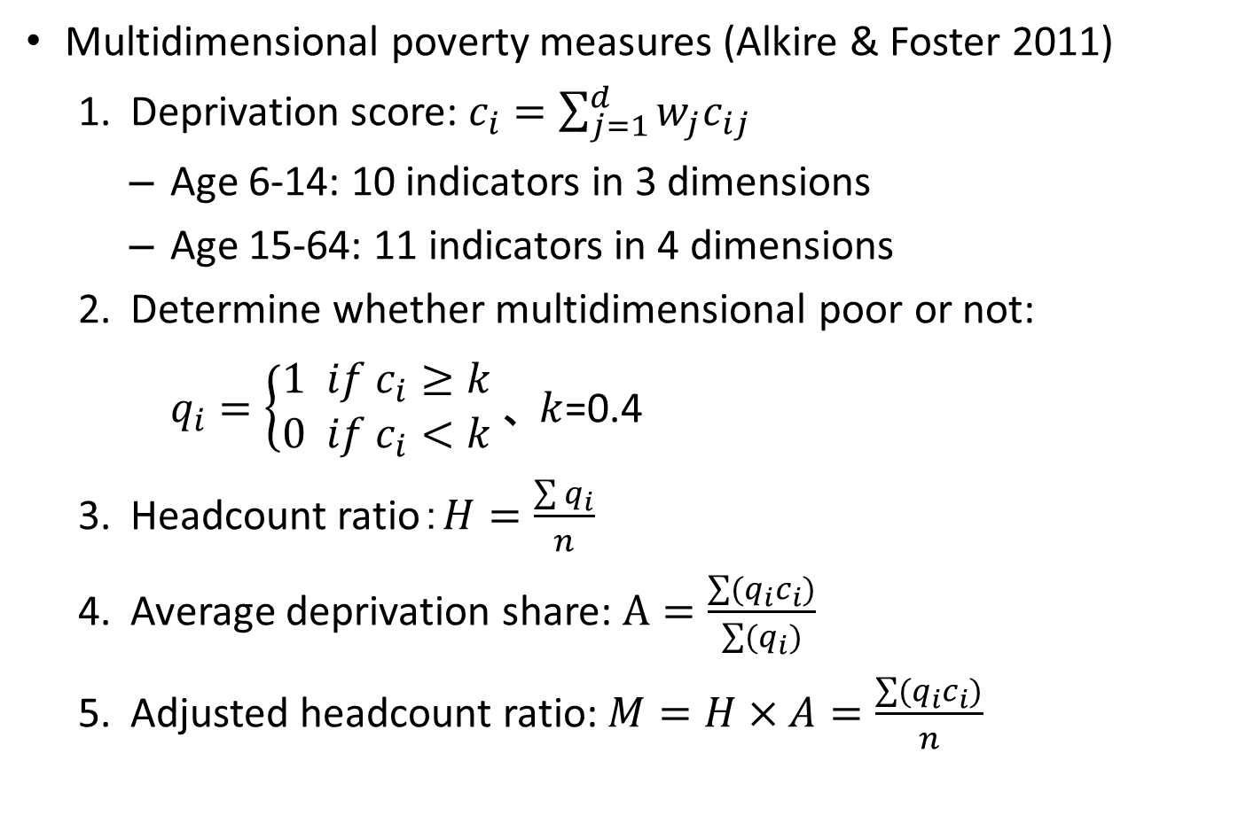
Multidimensional poverty measures
Multidimensional poverty measures (Alkire & Foster 2011)
Deprivation score: $c_{i}=\sum_{j=1}^{d}{w_{j}c_{ij}}$
  Age 6-14: 10 indicators in 3 dimensions
  Age 15-64: 11 indicators in 4 dimensions
Determine whether multidimensional poor or not:
$q_{i}=\left\{\begin{aligned}1 if c_{i}≥k \\ 0 if c_{i}<k\end{aligned}\right.、 k$=0.4
Headcount ratio：$H=\frac{\sum{q_{i}}}{n}$
Average deprivation share: $A=\frac{\sum{(q_{i}c_{i})}}{\sum{(q_{i})}}$
Adjusted headcount ratio: $M=H×A=\frac{\sum{(q_{i}c_{i})}}{n}$
-> Breadth of poverty
-> Depth of poverty

Slide 10
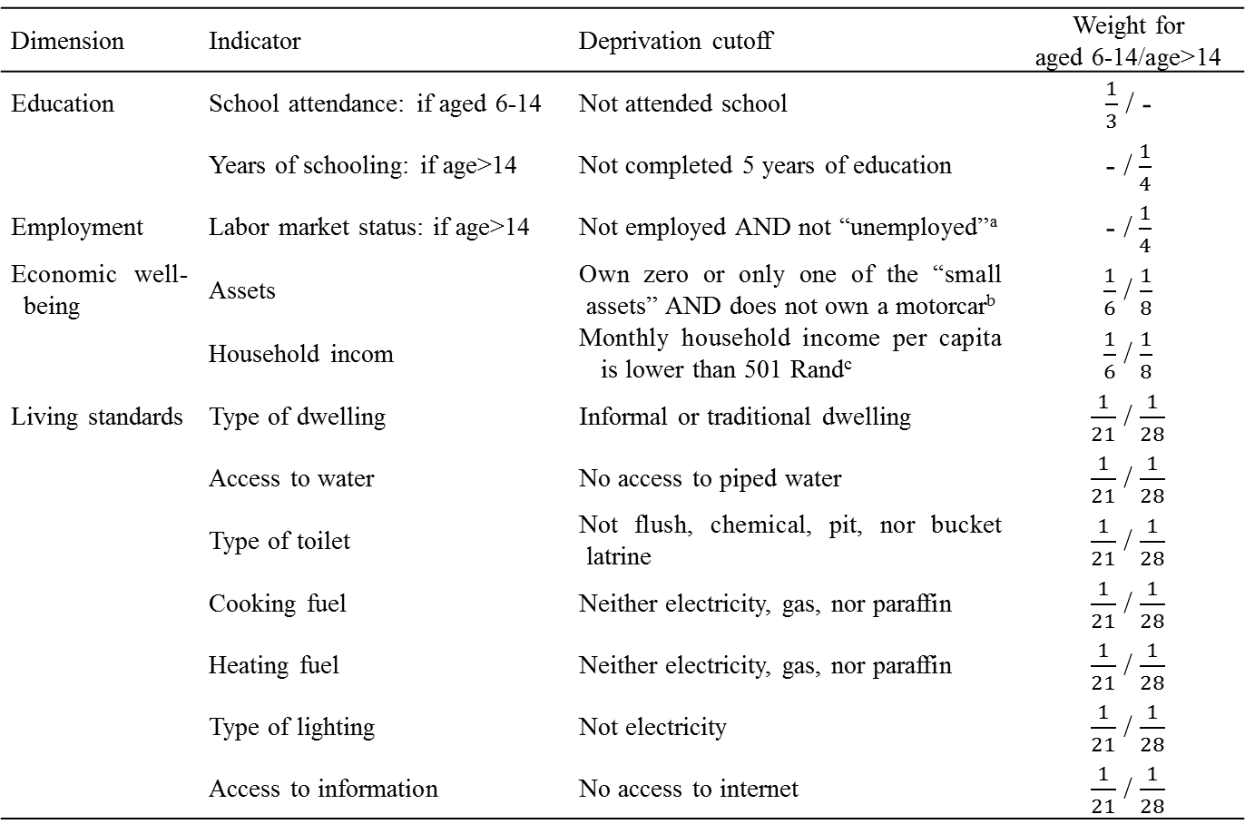
Dimension | Indicator | Deprivation cutoff | Weight for aged 6-14/age>14
Education | School attendance: if aged 6-14 | Not attended school | $\frac{1}{3}$ / -
 | Years of schooling: if age>14 | Not completed 5 years of education | - / $\frac{1}{4}$
Employment | Labor market status: if age>14 | Not employed AND not “unemployed”ª | - / $\frac{1}{4}$
Economic well-being | Assets | Own zero or only one of the “small assets” AND does not own a motorcar^{b} | $\frac{1}{6}$ / $\frac{1}{8}$
 | Household incom | Monthly household income per capita is lower than 501 Rand^{c} | $\frac{1}{6}$ / $\frac{1}{8}$
Living standards | Type of dwelling | Informal or traditional dwelling | $\frac{1}{21}$ / $\frac{1}{28}$
 | Access to water | No access to piped water | $\frac{1}{21}$ / $\frac{1}{28}$
 | Type of toilet | Not flush, chemical, pit, nor bucket latrine | $\frac{1}{21}$ / $\frac{1}{28}$
 | Cooking fuel | Neither electricity, gas, nor paraffin | $\frac{1}{21}$ / $\frac{1}{28}$
 | Heating fuel | Neither electricity, gas, nor paraffin | $\frac{1}{21}$ / $\frac{1}{28}$
 | Type of lighting | Not electricity | $\frac{1}{21}$ / $\frac{1}{28}$
 | Access to information | No access to internet | $\frac{1}{21}$ / $\frac{1}{28}$
Note) a: A person is defined as “unemployed” if s/he is not employed, but searches for a job and is prepared to start to work if a job offered. A person is defined as not deprived in this indicator if the reason for not searching for a job is health reasons, student, trainee, housewife, or being too old or young, or retirement. b: “Small assets” include refrigerator, electric/gas stove, vacuum cleaner, washing machine, computer, television, satellite television, DVD player, radio, telephone, cell phone. c: This criteria depends on the lower bound of national poverty line in 2011 (Statistics South Africa, 2015b).

Slide 11
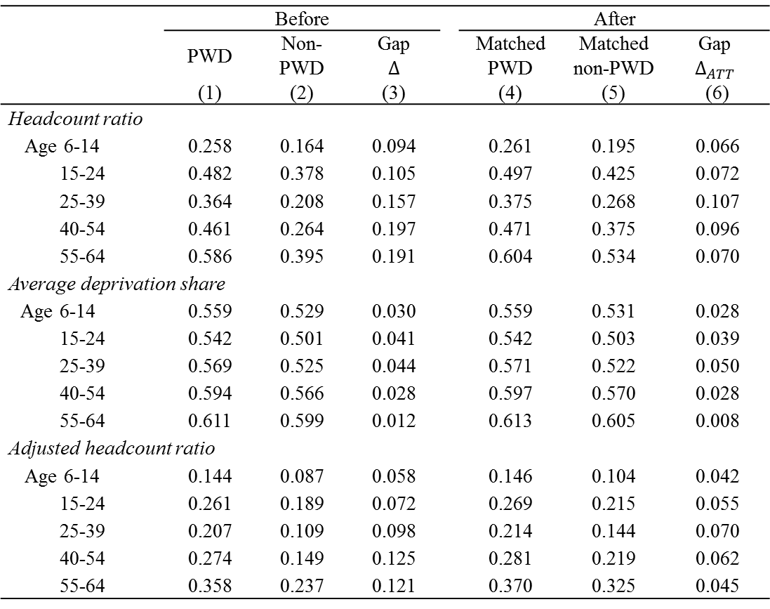
Comparison in multidimensional poverty measures
 | Before |  |  |  | After
 | PWD | Non- PWD | Gap $$∆$$ |  | Matched PWD | Matched non-PWD | Gap $$∆_{ATT}$$
 | (1) | (2) | (3) |  | (4) | (5) | (6)
Headcount ratio
Age 6-14 | 0.258 | 0.164 | 0.094 |  | 0.261 | 0.195 | 0.066
15-24 | 0.482 | 0.378 | 0.105 |  | 0.497 | 0.425 | 0.072
25-39 | 0.364 | 0.208 | 0.157 |  | 0.375 | 0.268 | 0.107
40-54 | 0.461 | 0.264 | 0.197 |  | 0.471 | 0.375 | 0.096
55-64 | 0.586 | 0.395 | 0.191 |  | 0.604 | 0.534 | 0.070
Average deprivation share
Age 6-14 | 0.559 | 0.529 | 0.030 |  | 0.559 | 0.531 | 0.028
15-24 | 0.542 | 0.501 | 0.041 |  | 0.542 | 0.503 | 0.039
25-39 | 0.569 | 0.525 | 0.044 |  | 0.571 | 0.522 | 0.050
40-54 | 0.594 | 0.566 | 0.028 |  | 0.597 | 0.570 | 0.028
55-64 | 0.611 | 0.599 | 0.012 |  | 0.613 | 0.605 | 0.008
Adjusted headcount ratio
Age 6-14 | 0.144 | 0.087 | 0.058 |  | 0.146 | 0.104 | 0.042
15-24 | 0.261 | 0.189 | 0.072 |  | 0.269 | 0.215 | 0.055
25-39 | 0.207 | 0.109 | 0.098 |  | 0.214 | 0.144 | 0.070
40-54 | 0.274 | 0.149 | 0.125 |  | 0.281 | 0.219 | 0.062
55-64 | 0.358 | 0.237 | 0.121 |  | 0.370 | 0.325 | 0.045
= 40.7%
= 25.5%
= 48.8%
= 28.5%
= 13.7%

Slide 12
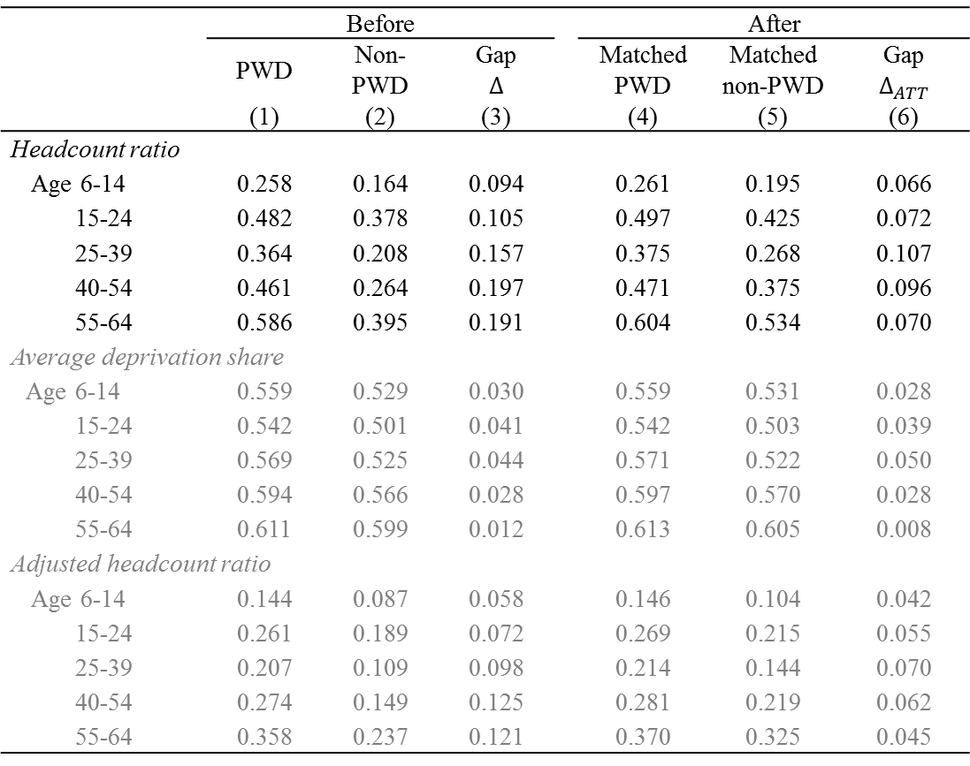
Comparison in multidimensional poverty measures
 | Before |  |  |  | After
 | PWD | Non- PWD | Gap $$∆$$ |  | Matched PWD | Matched non-PWD | Gap $$∆_{ATT}$$
 | (1) | (2) | (3) |  | (4) | (5) | (6)
Headcount ratio
Age 6-14 | 0.258 | 0.164 | 0.094 |  | 0.261 | 0.195 | 0.066
15-24 | 0.482 | 0.378 | 0.105 |  | 0.497 | 0.425 | 0.072
25-39 | 0.364 | 0.208 | 0.157 |  | 0.375 | 0.268 | 0.107
40-54 | 0.461 | 0.264 | 0.197 |  | 0.471 | 0.375 | 0.096
55-64 | 0.586 | 0.395 | 0.191 |  | 0.604 | 0.534 | 0.070
Average deprivation share
Age 6-14 | 0.559 | 0.529 | 0.030 |  | 0.559 | 0.531 | 0.028
15-24 | 0.542 | 0.501 | 0.041 |  | 0.542 | 0.503 | 0.039
25-39 | 0.569 | 0.525 | 0.044 |  | 0.571 | 0.522 | 0.050
40-54 | 0.594 | 0.566 | 0.028 |  | 0.597 | 0.570 | 0.028
55-64 | 0.611 | 0.599 | 0.012 |  | 0.613 | 0.605 | 0.008
Adjusted headcount ratio
Age 6-14 | 0.144 | 0.087 | 0.058 |  | 0.146 | 0.104 | 0.042
15-24 | 0.261 | 0.189 | 0.072 |  | 0.269 | 0.215 | 0.055
25-39 | 0.207 | 0.109 | 0.098 |  | 0.214 | 0.144 | 0.070
40-54 | 0.274 | 0.149 | 0.125 |  | 0.281 | 0.219 | 0.062
55-64 | 0.358 | 0.237 | 0.121 |  | 0.370 | 0.325 | 0.045
Matched non-PWD is poorer than unmatched
=> non-PWD similar to PWD is poorer
=> PWD is originally poor

Slide 13
Disaggregated analysis of adjusted headcount ratio
 | Age: 6-14 |  |  |  | Age: 15-24 |  |  |  | Age: 25-39 |  |  |  | Age: 40-54 |  |  |  | Age: 55-64
 | PWD | Non- PWD | Gap |  | PWD | Non- PWD | Gap |  | PWD | Non- PWD | Gap |  | PWD | Non- PWD | Gap |  | PWD | Non- PWD | Gap
 | (1) | (2) | (3) |  | (4) | (5) | (6) |  | (7) | (8) | (9) |  | (10) | (11) | (12) |  | (13) | (14) | (15)
Seeing: moderate | .086 | .077 | .009 |  | .198 | .189 | .009 |  | .135 | .122 | .013 |  | .230 | .206 | .024 |  | .328 | .307 | .021
severe | .207 | .143 | .064 |  | .305 | .249 | .056 |  | .206 | .152 | .054 |  | .283 | .225 | .059 |  | .422 | .323 | .099
Hearing: moderate | .159 | .121 | .038 |  | .292 | .228 | .064 |  | .248 | .155 | .093 |  | .325 | .224 | .101 |  | .426 | .338 | .088
severe | .226 | .140 | .086 |  | .335 | .255 | .080 |  | .228 | .163 | .065 |  | .318 | .233 | .086 |  | .455 | .342 | .112
Commun.: moderate | .188 | .118 | .071 |  | .348 | .222 | .126 |  | .363 | .170 | .193 |  | .392 | .236 | .156 |  | .452 | .344 | .108
severe | .232 | .113 | .119 |  | .393 | .232 | .160 |  | .345 | .165 | .180 |  | .389 | .244 | .144 |  | .429 | .338 | .091
Walking: moderate | .196 | .108 | .088 |  | .292 | .221 | .071 |  | .247 | .155 | .092 |  | .328 | .219 | .109 |  | .384 | .323 | .061
severe | .261 | .107 | .154 |  | .347 | .225 | .122 |  | .264 | .149 | .115 |  | .308 | .210 | .098 |  | .377 | .318 | .058
Remember: moderate | .149 | .103 | .046 |  | .343 | .226 | .117 |  | .331 | .180 | .152 |  | .394 | .278 | .116 |  | .458 | .386 | .072
severe | .210 | .106 | .103 |  | .383 | .230 | .153 |  | .342 | .164 | .178 |  | .385 | .241 | .144 |  | .478 | .349 | .129
Self-care: moderate |  |  |  |  | .346 | .237 | .110 |  | .318 | .174 | .144 |  | .382 | .240 | .142 |  | .447 | .360 | .087
severe |  |  |  |  | .329 | .223 | .106 |  | .343 | .163 | .180 |  | .384 | .223 | .161 |  | .459 | .353 | .106
Multiple difficulties | .237 | .115 | .122 |  | .381 | .234 | .148 |  | .353 | .174 | .179 |  | .380 | .248 | .132 |  | .429 | .354 | .076
 | Age: 6-14 |  |  |  | Age: 15-24 |  |  |  | Age: 25-39 |  |  |  | Age: 40-54 |  |  |  | Age: 55-64
 | PWD | Non- PWD | Gap |  | PWD | Non- PWD | Gap |  | PWD | Non- PWD | Gap |  | PWD | Non- PWD | Gap |  | PWD | Non- PWD | Gap
 | (1) | (2) | (3) |  | (4) | (5) | (6) |  | (7) | (8) | (9) |  | (10) | (11) | (12) |  | (13) | (14) | (15)
Seeing: moderate | .086 | .077 | .009 |  | .198 | .189 | .009 |  | .135 | .122 | .013 |  | .230 | .206 | .024 |  | .328 | .307 | .021
severe | .207 | .143 | .064 |  | .305 | .249 | .056 |  | .206 | .152 | .054 |  | .283 | .225 | .059 |  | .422 | .323 | .099
Hearing: moderate | .159 | .121 | .038 |  | .292 | .228 | .064 |  | .248 | .155 | .093 |  | .325 | .224 | .101 |  | .426 | .338 | .088
severe | .226 | .140 | .086 |  | .335 | .255 | .080 |  | .228 | .163 | .065 |  | .318 | .233 | .086 |  | .455 | .342 | .112
Commun.: moderate | .188 | .118 | .071 |  | .348 | .222 | .126 |  | .363 | .170 | .193 |  | .392 | .236 | .156 |  | .452 | .344 | .108
severe | .232 | .113 | .119 |  | .393 | .232 | .160 |  | .345 | .165 | .180 |  | .389 | .244 | .144 |  | .429 | .338 | .091
Walking: moderate | .196 | .108 | .088 |  | .292 | .221 | .071 |  | .247 | .155 | .092 |  | .328 | .219 | .109 |  | .384 | .323 | .061
severe | .261 | .107 | .154 |  | .347 | .225 | .122 |  | .264 | .149 | .115 |  | .308 | .210 | .098 |  | .377 | .318 | .058
Remember: moderate | .149 | .103 | .046 |  | .343 | .226 | .117 |  | .331 | .180 | .152 |  | .394 | .278 | .116 |  | .458 | .386 | .072
severe | .210 | .106 | .103 |  | .383 | .230 | .153 |  | .342 | .164 | .178 |  | .385 | .241 | .144 |  | .478 | .349 | .129
Self-care: moderate |  |  |  |  | .346 | .237 | .110 |  | .318 | .174 | .144 |  | .382 | .240 | .142 |  | .447 | .360 | .087
severe |  |  |  |  | .329 | .223 | .106 |  | .343 | .163 | .180 |  | .384 | .223 | .161 |  | .459 | .353 | .106
Multiple difficulties | .237 | .115 | .122 |  | .381 | .234 | .148 |  | .353 | .174 | .179 |  | .380 | .248 | .132 |  | .429 | .354 | .076
Larger impact of intellectual (remember & communication) and multiple difficulties
Impact: generally, severe difficulty > moderate difficulty

Slide 14
Disaggregated analysis of adjusted headcount ratio
 | Age: 6-14 |  |  |  | Age: 15-24 |  |  |  | Age: 25-39 |  |  |  | Age: 40-54 |  |  |  | Age: 55-64
 | PWD | Non- PWD | Gap |  | PWD | Non- PWD | Gap |  | PWD | Non- PWD | Gap |  | PWD | Non- PWD | Gap |  | PWD | Non- PWD | Gap
 | (1) | (2) | (3) |  | (4) | (5) | (6) |  | (7) | (8) | (9) |  | (10) | (11) | (12) |  | (13) | (14) | (15)
Male | .143 | .103 | .040 |  | .278 | .215 | .063 |  | .218 | .134 | .084 |  | .262 | .182 | .081 |  | .345 | .286 | .059
Female | .149 | .104 | .045 |  | .261 | .213 | .049 |  | .211 | .156 | .056 |  | .294 | .243 | .051 |  | .386 | .348 | .038
African | .154 | .110 | .044 |  | .289 | .232 | .057 |  | .230 | .160 | .070 |  | .309 | .244 | .065 |  | .409 | .362 | .047
Coloured | .074 | .043 | .031 |  | .155 | .100 | .055 |  | .166 | .072 | .094 |  | .187 | .118 | .069 |  | .247 | .183 | .064
Indian | .038 | .027 | .011 |  | .075 | .036 | .039 |  | .066 | .028 | .038 |  | .073 | .044 | .029 |  | .125 | .090 | .035
White | .011 | .015 | -.004 |  | .064 | .020 | .044 |  | .035 | .015 | .020 |  | .021 | .015 | .006 |  | .023 | .023 | .000
Urban area | .081 | .049 | .032 |  | .169 | .124 | .045 |  | .135 | .077 | .057 |  | .184 | .123 | .061 |  | .253 | .197 | .056
Rural formal area | .314 | .237 | .077 |  | .359 | .298 | .061 |  | .321 | .231 | .090 |  | .413 | .323 | .090 |  | .495 | .465 | .030
Tribal area | .195 | .146 | .049 |  | .389 | .320 | .069 |  | .350 | .260 | .089 |  | .434 | .370 | .063 |  | .521 | .487 | .034
 | Age: 6-14 |  |  |  | Age: 15-24 |  |  |  | Age: 25-39 |  |  |  | Age: 40-54 |  |  |  | Age: 55-64
 | PWD | Non- PWD | Gap |  | PWD | Non- PWD | Gap |  | PWD | Non- PWD | Gap |  | PWD | Non- PWD | Gap |  | PWD | Non- PWD | Gap
 | (1) | (2) | (3) |  | (4) | (5) | (6) |  | (7) | (8) | (9) |  | (10) | (11) | (12) |  | (13) | (14) | (15)
Male | .143 | .103 | .040 |  | .278 | .215 | .063 |  | .218 | .134 | .084 |  | .262 | .182 | .081 |  | .345 | .286 | .059
Female | .149 | .104 | .045 |  | .261 | .213 | .049 |  | .211 | .156 | .056 |  | .294 | .243 | .051 |  | .386 | .348 | .038
African | .154 | .110 | .044 |  | .289 | .232 | .057 |  | .230 | .160 | .070 |  | .309 | .244 | .065 |  | .409 | .362 | .047
Coloured | .074 | .043 | .031 |  | .155 | .100 | .055 |  | .166 | .072 | .094 |  | .187 | .118 | .069 |  | .247 | .183 | .064
Indian | .038 | .027 | .011 |  | .075 | .036 | .039 |  | .066 | .028 | .038 |  | .073 | .044 | .029 |  | .125 | .090 | .035
White | .011 | .015 | -.004 |  | .064 | .020 | .044 |  | .035 | .015 | .020 |  | .021 | .015 | .006 |  | .023 | .023 | .000
Urban area | .081 | .049 | .032 |  | .169 | .124 | .045 |  | .135 | .077 | .057 |  | .184 | .123 | .061 |  | .253 | .197 | .056
Rural formal area | .314 | .237 | .077 |  | .359 | .298 | .061 |  | .321 | .231 | .090 |  | .413 | .323 | .090 |  | .495 | .465 | .030
Tribal area | .195 | .146 | .049 |  | .389 | .320 | .069 |  | .350 | .260 | .089 |  | .434 | .370 | .063 |  | .521 | .487 | .034
Larger impact for
Males except for aged 6-14, the highest ratio for disabled females aged 40+
Africans & Coloureds (African/Coloured non-PWDs > Indian/White PWDs)
Rural formal & Tribal areas (Non-PWDs in rural formal/tribal areas > PWDs in urban area)
=> Past disadvantages -> multiple discrimination

Slide 15
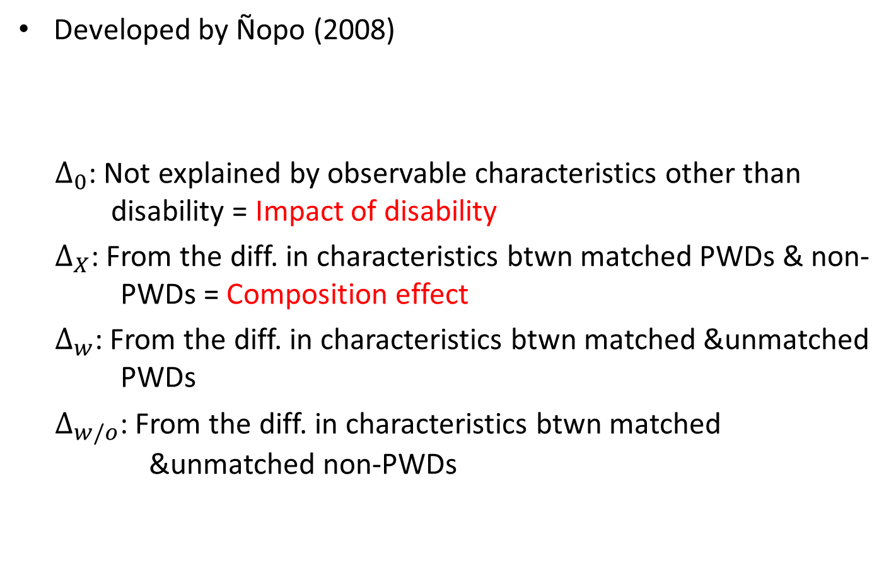
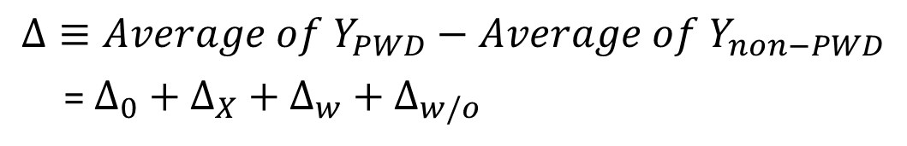
Matching-based decomposition
Developed by Ñopo (2008)
  $Δ_{0}$: Not explained by observable characteristics other than disability = Impact of disability
  $Δ_{X}$: From the diff. in characteristics btwn matched PWDs & non-PWDs = Composition effect
  $Δ_{w}$: From the diff. in characteristics btwn matched &unmatched PWDs
  $Δ_{w/o}$: From the diff. in characteristics btwn matched &unmatched non-PWDs
$$Δ≡Average of Y_{PWD}−Average of Y_{non−PWD}$$
= $Δ_{0}+{Δ_{X}+Δ}_{w}+Δ_{w/o}$

Slide 16
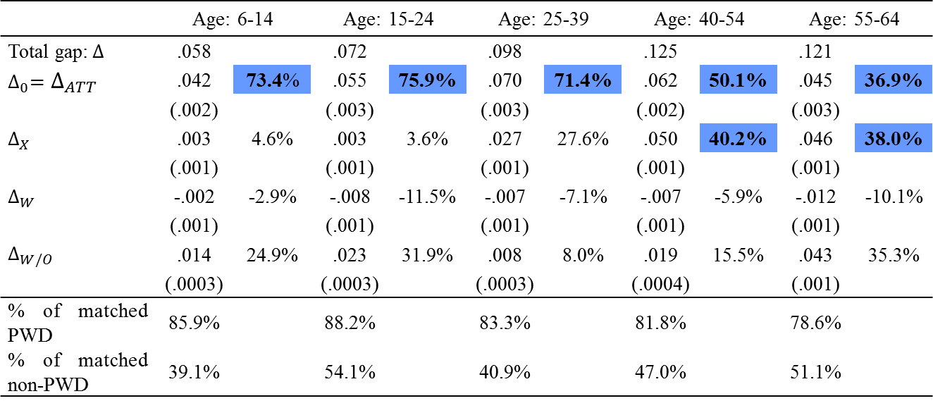
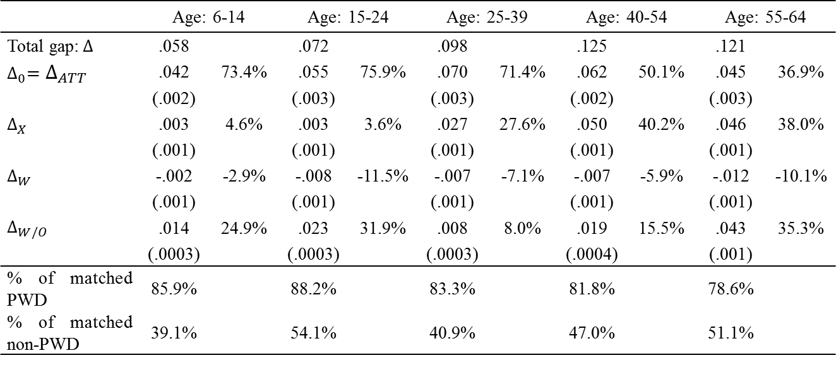
Decomposition of the gap in adjusted headcount ratio
 | Age: 6-14 |  | Age: 15-24 |  | Age: 25-39 |  | Age: 40-54 |  | Age: 55-64
Total gap:$∆$ | .058 |  | .072 |  | .098 |  | .125 |  | .121
$$∆_{0}=∆_{ATT}$$ | .042 | 73.4% | .055 | 75.9% | .070 | 71.4% | .062 | 50.1% | .045 | 36.9%
 | (.002) |  | (.003) |  | (.003) |  | (.002) |  | (.003)
$$∆_{X}$$ | .003 | 4.6% | .003 | 3.6% | .027 | 27.6% | .050 | 40.2% | .046 | 38.0%
 | (.001) |  | (.001) |  | (.001) |  | (.001) |  | (.001)
$$∆_{W}$$ | -.002 | -2.9% | -.008 | -11.5% | -.007 | -7.1% | -.007 | -5.9% | -.012 | -10.1%
 | (.001) |  | (.001) |  | (.001) |  | (.001) |  | (.001)
$$∆_{W/O}$$ | .014 | 24.9% | .023 | 31.9% | .008 | 8.0% | .019 | 15.5% | .043 | 35.3%
 | (.0003) |  | (.0003) |  | (.0003) |  | (.0004) |  | (.001)
% of matched PWD | 85.9% |  | 88.2% |  | 83.3% |  | 81.8% |  | 78.6%
% of matched non-PWD | 39.1% |  | 54.1% |  | 40.9% |  | 47.0% |  | 51.1%
 | Age: 6-14 |  | Age: 15-24 |  | Age: 25-39 |  | Age: 40-54 |  | Age: 55-64
Total gap:$∆$ | .058 |  | .072 |  | .098 |  | .125 |  | .121
$$∆_{0}=∆_{ATT}$$ | .042 | 73.4% | .055 | 75.9% | .070 | 71.4% | .062 | 50.1% | .045 | 36.9%
 | (.002) |  | (.003) |  | (.003) |  | (.002) |  | (.003)
$$∆_{X}$$ | .003 | 4.6% | .003 | 3.6% | .027 | 27.6% | .050 | 40.2% | .046 | 38.0%
 | (.001) |  | (.001) |  | (.001) |  | (.001) |  | (.001)
$$∆_{W}$$ | -.002 | -2.9% | -.008 | -11.5% | -.007 | -7.1% | -.007 | -5.9% | -.012 | -10.1%
 | (.001) |  | (.001) |  | (.001) |  | (.001) |  | (.001)
$$∆_{W/O}$$ | .014 | 24.9% | .023 | 31.9% | .008 | 8.0% | .019 | 15.5% | .043 | 35.3%
 | (.0003) |  | (.0003) |  | (.0003) |  | (.0004) |  | (.001)
% of matched PWD | 85.9% |  | 88.2% |  | 83.3% |  | 81.8% |  | 78.6%
% of matched non-PWD | 39.1% |  | 54.1% |  | 40.9% |  | 47.0% |  | 51.1%
Larger impact of disability for younger groups (6-14, 15-24, 25-39)
Larger composition effect for older groups (40-54, 55-64)
=> Poverty conditions of the older already determined before having impairments.
Older disability groups include more the disadvantaged and persons with mild
difficulties in seeing, walking, and remembering.

Slide 17
Conclusions
In South Africa, PWDs are more multidimensionally deprived even after equalizing PWDs and non-PWDs in other factors
Impact of disability is larger for the subgroups of
  Intellectual/multiple difficulties, walking (Age 6-24), self-care (Age 25-54) => Need of approach flexible to type of difficulty
  Africans, Coloureds, residents in rural formal/tribal areas => Need of mainstreaming of disability in other policies
The poverty gap is explained by disability for Age 6-39 and disability/other factors for Age 40-
  => Need of comprehensive approach, not only disability-specific
Finding of the causality from poverty to disability
=> Promotion of early detection/treatment of health problems
Thank you for your attention!

