Slide 1
Disability Employment Module
Daniel Mont
December 2016
Pretoria, South Africa

Slide 2
Overall picture
Difficult to get timely, reliable, comparable statistics on labour force characteristics of people with disabilities
The quality and quantity of data available varies enormously across the world
Disability is not systematically monitored (variable covered but not processed against labour force characteristics)
Variety of sources (varying degree of limitations)
Censuses
Household surveys and specialized disability surveys
Various types of administrative data
Establishment surveys
Different classifications, concepts, definitions and questionnaires
Different indicators
Reported employment-to-population ratios vary from less than 10% to more than 60%

Slide 3
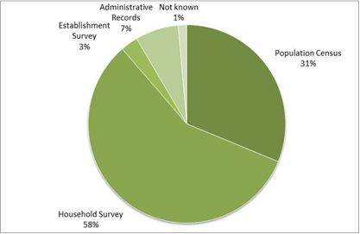
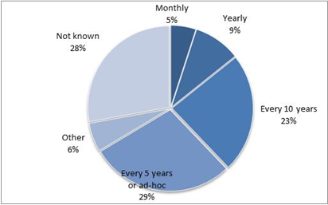
Type of sources (118 countries) Periodicity of data collection (118 countries)

Slide 4
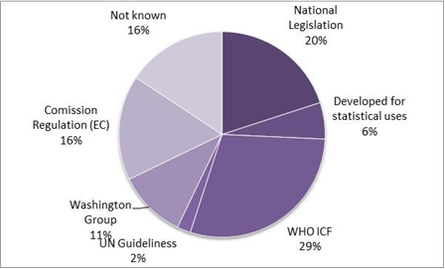
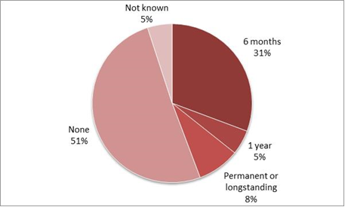

Slide 5
Questions used to identify persons with disabilities
Direct questions related to impairment/body functioning (but also registered work related disability)
The respondent is directly asked if she/he is disabled, or
The respondent is asked if she/he has physical impairment; visual impairment; deafness/hearing impairment; muteness/severe speech problem; deaf-mute; permanent disfigurement; psychiatric and intellectual disability; multiple disability; paralyzed;
Questions related to difficulties people face while performing daily activities
The respondent is asked if she/has difficulties in performing activities of daily living such as seeing, hearing, speaking, remembering, concentrating or communicating, mobility difficulties, etc.
Questions related to limitations/participation in the labour market (kind and amount of work they can do)

Slide 6
Overall picture
Difficult to get timely, reliable, comparable statistics on labour force characteristics of people with disabilities
The quality and quantity of data available varies enormously across the world
Disability is not systematically monitored (variable covered but not processed against labour force characteristics)
Variety of sources (varying degree of limitations)
Censuses
Household surveys and specialized disability surveys
Various types of administrative data
Establishment surveys
Different classifications, concepts, definitions and questionnaires
Different indicators
Reported employment-to-population ratios vary from less than 10% to more than 60%

Slide 7
Purpose of Disability Labor Force Module
Disaggregation of standard labor force indicators
Labor force participation
Unemployment
Employment
Type of Employment
Specific indicators for people with disabilities

Slide 8
Placement in Labor Force Survey
Standard demographic data
Disability identification questions
Standard employment indicators
If the person has a disability:
Special set of questions on barriers and the nature of their work
Questions on attitudes towards disability and employment

Slide 9
Disability Identification
Abbreviated version of Extended Set
Core six questions (with skips for glasses and hearing aids)
Additional question on upper body
Questions on anxiety and depression

Slide 10
Categories of disability questions related to employment
Barriers
Accommodations
Social Protection
Attitudes (asked of all people)

Slide 11
Barriers
For all PWD who are inactive (not employed and not looking for work)
EW_1a Which of the following, if any, would make it more likely for [you/him/her] to seek employment. Check all that apply.
Training to qualify for available jobs
Transportation from my home to available jobs
Help in locating available jobs
Greater belief that someone will hire me
Assistive devices or technology to help me do the job
A work place that accommodates people with disabilities
Other: Please specify _________________

Slide 12
ATT_3 How supportive would [your/his/her] family members be if you decide to work?
Very supportive
Somewhat supportive
Not supportive

Slide 13
Accommodations
For PWD who are employed
WA_1 Has [your/his/her] workplace been set up in a way to account for difficulties you have in doing certain activities?
Yes (go to WA_1a)
No (go to WA_1b)

Slide 14
WA_1a Would more modifications be needed?
WA_1b Would you need any modification?
Yes
No

Slide 15
WA_2 Is [your/his/her] work schedule arranged to account for difficulties you have in doing certain activities?
Yes (go to WA_2a)
No (go to WA_2b)

Slide 16
WA_2a Would you need any other arrangement of your work schedule?
WA_2b Would you need your work schedule to be changed?
Yes
No

Slide 17
WA_3 Are [your/his/her] work tasks arranged to account for difficulties you have in doing certain activities?
Yes (go to WA_3a)
No (go to WA_3b)

Slide 18
WA_3a Would you need any other arrangement of your tasks?
WA_3b Would you need your tasks to be changed?
Yes
No

Slide 19
Social Protection
For PWD that are employed
SP_1 Do you receive any cash benefits from the government linked to your disability?
SP_1a Do you know if the amount of the benefit will change if your salary increases?
Yes
No

Slide 20
For PWD unemployed or inactive
SP_2 Do you receive any cash benefits from the government linked to your disability?
Yes
No
SP_2a Will you keep the benefit if you find a paid job?
Yes
Yes, but the amount will decrease
No

Slide 21
Attitudes
ATT_1 How willing are employers to hire people with disabilities?
ATT_2 How willing are people to work alongside people with disabilities?
Unwilling
Somewhat willing
Very willing

Slide 22
Cognitive Testing
First round done at NCHS in United States, with subsequent revisions
Second round at NCHS happening soon
Need to roll out cognitive testing to more countries, possibly starting with India

Slide 23
THANK YOU

