Slide 1
To Age-Adjust or Not To Age-Adjust?

Slide 2
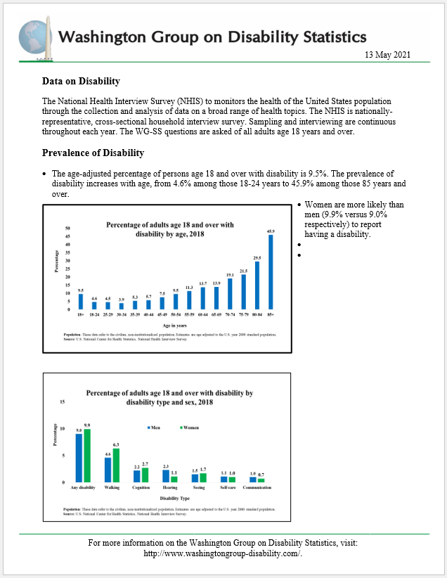
Objectives
WG interest in developing a short disability report for use by countries as a way of making comparable disability statistics available
Question was raised as to whether the prevalence estimates should be crude or age-adjusted
Session is designed to provide background information on age-adjustment for use in determining what should be shown on the reports
Proposed outcome: constitution of small group to develop Best Practice recommendations to present at annual meeting or at a special webinar

Slide 3
The Anatomy of a Rate
Population Rate Calculation
1. Simple method:
Rate = number of cases in the population with a characteristic ÷ total number of cases
2. More complicated method:
Any population can be divided into components (e.g., age groups)
Rate = sum of component-specific rates multiplied by a distribution of the population by that component
Distribution would come from the data set that the component specific rates come from
rate component 1 x proportion of population component 1
rate component 2 x proportion of population component 2
. .
. .
rate component n x proportion of the population component n
∑ of products = rate

Slide 4
The Anatomy of a Rate
CRUDE RATE – sum of the component-specific (e.g., age) rates multiplied by the component (age) distribution of the same population that the component-specific rates come from
ADJUSTED or STANDARDIZED RATE – sum of the component-specific (e.g., age) rates multiplied by the component (age) distribution of a different population

Slide 5
Why Use an Adjusted or Standardized Rate?
Adjusted rates are NOT ‘real’ – they do not reflect the actual situation in the population -- the crude rates does this; the adjusted rate is a function of the age distribution used
Adjusted rates are used for comparisons
Across time in the same population (country) – for example, trends over the last x years
Across different subgroups in the same population – for example, males vs females
Across populations – for example, across countries
Adjusted rates are used when
The comparisons should not be affected by the underlying composition of population (for example, the age distribution)
When a summary indicator is needed rather than looking at the component-specific rates
Adjusted rates should not be used if the relationship between the component specific rates varies across population to be compared

Slide 6
When is the Composition of the Population Not of Interest?
Most demographic and health-related characteristics vary by age so adjustment by age is the most common kind of adjustment
Decision to use crude or age-adjusted rates is a function of the intended use of the estimate
Example 1: planners need an estimate of the number of people with vision difficulties in urban and rural areas to determine the need for services
Example 2: researchers need estimates of vision difficulties in urban and rural areas to see if exposure to area specific irritants is a determinant of vision difficulties

Slide 7
Crude vs Age-Adjusted Rates
Vision difficulties are age-related and the population in rural areas is older
Example 1:
requires estimates of ‘burden’ given by a crude rate
the fact that the population is older in rural areas would translate into greater ‘burden’ in that area and the need for more services
Example 2:
requires estimates of ‘risk’ given by adjusted rates
the hypothesis is that risk of vision difficulties is related to irritants in urban areas but observed higher rates in rural areas could be a function of the age of the population not exposure
In this example, the age distribution of the population does not affect the comparison of ‘risk’ due to exposure and is not of interest
age-adjusted rates control for the different age distributions so that differences in ‘risk’ can be estimated

Slide 8
The Impact of Age Adjustment on Disability Prevalence
Examples using data from 3 countries – Country A (5 and over and 18 and over), Country B (18 and over), and Country C (5 and over and 18 and over) – with different underlying age structures are used for illustrative purposes only; assume data are from the census
Step 1: Calculate the crude rates for each country
Step 2: Calculate age-specific rates for each country
Step 3: Calculate the age-adjusted rates by weighting the age-specific rates for each country using the age distributions from the census for the other countries – this gives 4 estimates for 5 and over and 9 estimates for 18 and over
Step 4: Compare crude vs adjusted estimates using the different age distributions (standards)

Slide 9
Step 1: Calculate the crude disability rates (percentages)
Age | Country A | Country B | Country C
5 years and over | 1.8 |  | 8.1
18 years and over | 2.4 | 9.1 | 9.0

Slide 10
Step 2: Calculate crude age-specific disability rates
Age group | Country A | Country B | Country C
5-17 years | 0.8 |  | 3.7
18-29 years | 0.9 | 2.9 | 3.7
30-39 years | 1.2 | 3.7 | 4.0
40-49 years | 1.9 | 6.2 | 5.4
50-59 years | 3.6 | 13.4 | 10.2
60-69 years | 6.9 | 16.5 | 12.3
70-79 years | 14.4 | 31.3 | 16.5
80+ years | 26.8 | 50.9 | 33.3

Slide 11
Step 3: Calculate Age Adjusted rates - Country Age Distributions
Country A
Country B
Country C

Slide 12
Step 3: Calculate age-adjusted disability rates - population 5 years and over
 | Country A age-specific disability rate | Country A age-specific rate x Country C age-distribution |  | Country C age-specific disability rate | Country C age-specific rate x Country A age-distribution
5-17 | 0.8 | 0.1 |  | 3.8 | 1.4
18-29 | 0.9 | 0.2 |  | 3.7 | 0.9
30-39 | 1.2 | 0.2 |  | 4.0 | 0.6
40-49 | 1.9 | 0.3 |  | 5.4 | 0.6
50-59 | 3.6 | 0.5 |  | 10.2 | 0.6
60-69 | 6.9 | 0.9 |  | 12.3 | 0.4
70-79 | 14.4 | 1.1 |  | 16.5 | 0.3
80+ | 26.8 | 1.1 |  | 33.3 | 0.3

Slide 13
Step 3: Calculate age-adjusted disability rates - population 18 years and over
 | Country A age-specific disability rate | Country A age-specific estimate x Country B age-distribution | Country A age-specific estimate x Country C age-distribution |  | Country B age-specific disability rate | Country B age-specific estimate x Country A age-distribution | Country B age-specific estimate x Country C age-distribution |  | Country C age-specific disability rate | Country C age-specific estimate x Country A age-distribution | Country C age-specific estimate x Country B age-distribution
18-29 | 0.9 | 0.2 | 0.2 |  | 2.9 | 1.2 | 0.6 |  | 3.7 | 1.5 | 1.0
30-39 | 1.2 | 0.3 | 0.2 |  | 3.7 | 0.9 | 0.6 |  | 4.0 | 1.0 | 1.0
40-49 | 1.9 | 0.3 | 0.3 |  | 6.2 | 1.0 | 1.0 |  | 5.4 | 0.9 | 0.9
50-59 | 3.6 | 0.5 | 0.6 |  | 13.4 | 1.3 | 2.2 |  | 10.2 | 1.0 | 1.5
60-69 | 6.9 | 0.7 | 1.1 |  | 16.5 | 0.8 | 2.5 |  | 12.3 | 0.6 | 1.3
70-79 | 14.4 | 0.7 | 1.4 |  | 31.3 | 0.8 | 2.9 |  | 16.5 | 0.4 | 0.8
80+ | 26.8 | 0.6 | 1.3 |  | 50.9 | 0.7 | 2.5 |  | 33.3 | 0.4 | 0.7

Slide 14
Step 4: What happens to rates when they are age-adjusted?
5 years and over
 | Crude rate (%) | Age-Adjusted Rate using Country C age distribution (%) | Age-Adjusted Rate using Country A age distribution (%)
Country A | 1.8 | 4.3
Country C | 8.1 |  | 5.1
18 years and over
 | Crude rate (%) | Age-Adjusted Rate using Country A age distribution (%) | Age-Adjusted Rate using Country B age distribution (%) | Age-Adjusted Rate using Country C age distribution (%)
Country A | 2.4 |  | 3.4 | 5.0
Country B | 9.1 | 6.7 |  | 12.4
Country C | 9.0 | 5.8 | 7.2

Slide 15
Legends
Each country is assigned a color
Country A is blue
Country B is orange
Country C is green
Solid colors – indicate crude rates (rates calculated using the age distribution of that country)
Diagonal lines – indicate age-adjustment
Outline colors – indicate which countries age distribution is used for the age adjustment

Slide 16
Crude Disability Rates

Slide 17
What happens when rates are age adjusted?
5 years and over

Slide 18
What happens when rates are age-adjusted?
18 years and over

Slide 19
Comparisons when based on same age distribution – 5 years and over
5 years and over

Slide 20
Comparisons when based on same age distribution – 18 years and over
18 years and over

Slide 21
Impact of Adjustment
Three countries have different age distributions – Country A has the youngest, followed by Country B. Country C has the oldest age distribution
Three countries have different age-specific rates
The effect of age adjustment depends on which age distribution is used
Using Country A’s younger age distribution lowers the rate in Countries B (from 9.1 to 6.7) and C (from 9.0 to 5,8) for the population 18 and over
Using Country C’s older age distribution raises the rates in Countries A (from 2.4 to 5.0) and B (from 9.1 to 12.4) for the population 18 and over
Comparisons across countries will change depending on which age distribution (standard) is used

Slide 22
Next Steps
Should WG products that include prevalence estimates from more than one country present crude or age-adjusted estimates?
Will including both be confusing and take space if multiple prevalences are given (for example, for all domains)?
If adjustment is to used, which age composition (standard) should be used?
Is there consensus on these topics? The floor is open – please raise your hand if you would like to speak or put your comments in the chat
Either way we need volunteers for a group to determine Best Practice Recommendations for to address this issue
Time limited group
Recommendations to be presented at the Fall annual meeting or at a special webinar
Any volunteers?

