Slide 1
WG Website Redesign
Mitchell Loeb & Angela Sarkisian
University College London

Slide 2
Website Purpose
Two types of users:
those who are new to the WG work and want to learn more, and
those that are knowledgeable about the WG and want access to resources
Broad purposes:
Inform
Share
Update
Keeping in mind:
The needs of different types of users
Best practices for website design
Notes:
Purpose of the website depends upon the type of user accessing the website.
If everyone who came to the site was a subject area expert on disability, and quite familiar with the WG, then the site could be little more than a library of resources.

Slide 3
WG Website Objectives
The development of working networks
Facilitate communication (news, information sharing)
Sharing of best practices, methodologies (FAQ’s, blogs)
Capitalize on experiences (blogs)
The provision of technical support
Information about WG tools for measuring disability (question sets, documentation)
The provision of resources
To guide and support implementation (translation, syntax)

Slide 4
The Current WG Website

Slide 5
Why did we redesign?
Improve dissemination
Make information easy to find
Organize information in an intuitive manner
Improve navigation
Assess the utility and placement of links
Simplify common “paths” and movement across pages
Improve design
Incorporate responsive design features for use on all devices
Improve technical performance

Slide 6
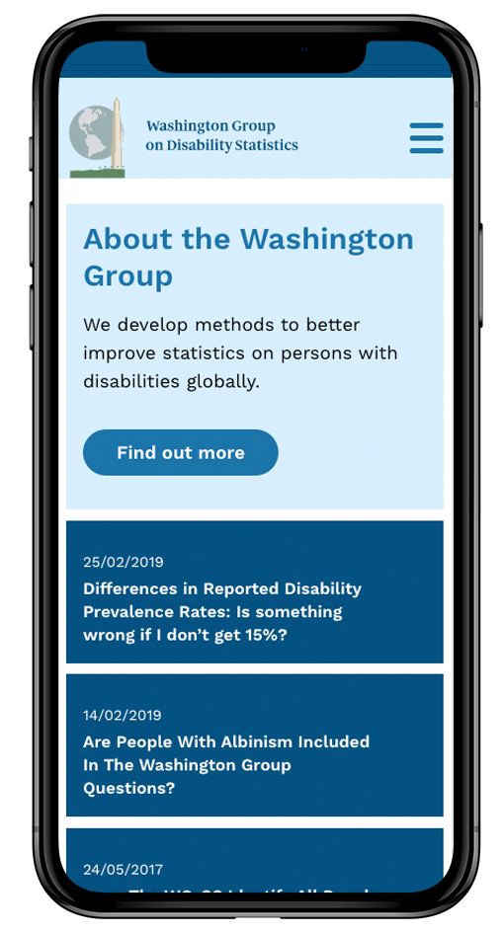
The New WG Website
Notes:
The homepage features prominent links to the latest insight from the WG blog.
The homepage also features ‘quick links’ to the Question sets, and implementati
on guidelines.
The main navigation has been simplified, and features drop down menus for visitors to get to the information they are looking for quickly and efficiently.

Slide 7
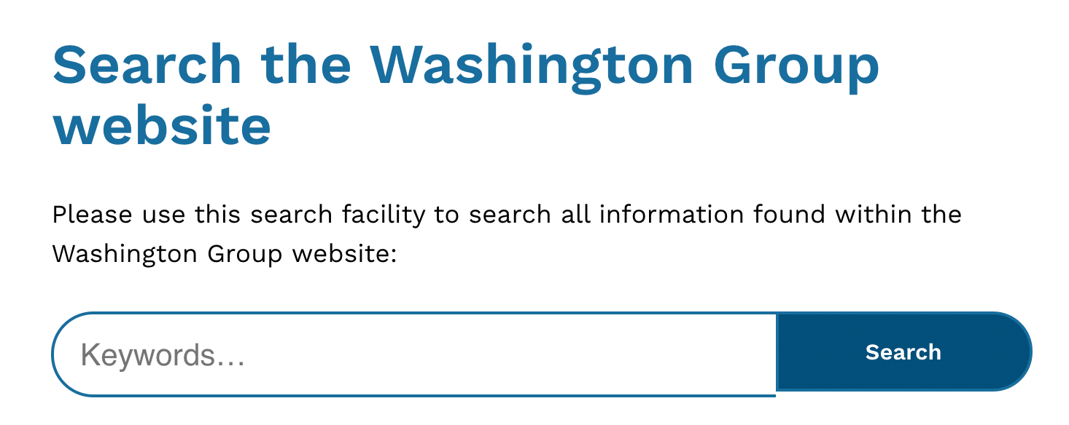
Additional Website Enhancements
Implemented a powerful site-wise search function
The new search engine not only searches over all the WG website pages but also all the downloadable documents on the site.
Created a fully responsive website
Responsive web design is a design and development philosophy that enables a website to identify different screen sizes and serve up the appropriate experience using the same code-base.
Notes:
By surfacing PDF metadata to the search engine, the search tool now becomes a valuable tool for hunting down information.
In practical terms, this means whatever device a visitor is viewing the site with, be it a mobile, tablet or laptop, all functionality is available and the design scales to fit the screen.

Slide 8
Website Enhancements Continued
Created a Google-friendly website
A well built website means a quick and fast loading website and a website Google will not penalize and ‘down rank’.
Created an accessible and inclusive website
The new website follows the Web Content Accessibility Guidelines, and we have managed to get the website to ‘AAA’ standard.
Notes:
By following ‘best practice’ when it comes to the technical build, we have created a site with improved load speeds, and improved performance when bandwidth or internet connections are poor.
Colors all have a high contrast ratio, font sizes are large, text blocks are narrow (all to aid legibility), and certain color combinations that are problematic with those with color recognition issues have been avoided

Slide 9
Next Steps
Technical functioning
ironing out any bugs
Ensuring consistency in content and design
e.g., names listed on primary and global navigation bars
Adding new content in an organized, intuitive manner
Archiving old content
Key words
for successful search functionality
Testing and assessing accessibility
Notes:
Beyond the wireframes, small design issues remain (buttons, clicks and dropdowns)

Slide 10
WG Website: A work in progress
Contributions
News items, blogs, articles, and publications that make use of WG tools
Questions
Questions may become FAQs posted on the website
Suggestions
Format-related, additional sections and/or content-related

Slide 11
Acknowledgements

